Slide 1
Database Systems For M.Tech CSE
Dr. N. GANESH M.E. [CSE]., MBA[HR]., M.L.[IPR]., Ph.D. [CSE]
School of Computer Science and Engineering,
VIT Chennai Campus
Email: ganesh.narayanan@vit.ac.in
Mobile: 9841737667

Slide 2
Data and Information
Data: Raw Facts – Truths
Information: Processed Data / Refined Data

Slide 3
Database and DBMS
A database is an organized collection of structured information, or data, typically stored electronically in a computer system.
A database is usually controlled by a database management system (DBMS).

Slide 4
Database Systems
DBMS contains information about a particular enterprise
Collection of interrelated data
Set of programs to access the data
An environment that is both convenient and efficient to use
Database systems are used to manage collections of data that are:
Highly valuable
Relatively large
Accessed by multiple users and applications, often at the same time.
A modern database system is a complex software system whose task is to manage a large, complex collection of data.
Databases touch all aspects of our lives
Notes:
4

Slide 5
Database Applications Examples
Enterprise Information
Sales: customers, products, purchases
Accounting: payments, receipts, assets
Human Resources: Information about employees, salaries, payroll taxes.
Manufacturing: management of production, inventory, orders, supply chain.
Banking and finance
customer information, accounts, loans, and banking transactions.
Credit card transactions
Finance: sales and purchases of financial instruments (e.g., stocks and bonds; storing real-time market data
Universities: registration, grades
Notes:
5

Slide 6
Database Applications Examples (Cont.)
Airlines: reservations, schedules
Telecommunication: records of calls, texts, and data usage, generating monthly bills, maintaining balances on prepaid calling cards
Web-based services
Online retailers: order tracking, customized recommendations
Online advertisements
Document databases
Navigation systems: For maintaining the locations of various places of interest along with the exact routes of roads, train systems, buses, etc.
Notes:
6

Slide 7
Purpose of Database Systems
In the early days, database applications were built directly on top of file systems, which leads to:
Data redundancy and inconsistency: data is stored in multiple file formats resulting in duplication of information in different files
Difficulty in accessing data
Need to write a new program to carry out each new task
Data isolation
Multiple files and formats
Integrity problems
Integrity constraints
Hard to add new constraints or change existing ones
Notes:
7

Slide 8
Purpose of Database Systems (Cont.)
Atomicity of updates
Failures may leave database in an inconsistent state with partial updates carried out
Example: Transfer of funds from one account to another should either complete or not happen at all
Concurrent access by multiple users
Concurrent access needed for performance
Uncontrolled concurrent accesses can lead to inconsistencies
Ex: Two people reading a balance (say 100) and updating it by withdrawing money (say 50 each) at the same time
Security problems
Hard to provide user access to some, but not all, data
Database systems offer solutions to all the above problems
Notes:
8

Slide 9
University Database Example
Data consists of information about:
Students
Instructors
Classes
Application program examples:
Add new students, instructors, and courses
Register students for courses, and generate class rosters
Assign grades to students, compute grade point averages (GPA) and generate transcripts
Notes:
9

Slide 10
View of Data
A database system is a collection of interrelated data and a set of programs that allow users to access and modify these data.
A major purpose of a database system is to provide users with an abstract view of the data.
Data models
A collection of conceptual tools for describing data, data relationships, data semantics, and consistency constraints.
Data abstraction
Hide the complexity of data structures to represent data in the database from users through several levels of data abstraction.
Notes:
10

Slide 11
Data Models
A collection of tools for describing
Data
Data relationships
Data semantics
Data constraints
Relational model
Entity-Relationship data model (mainly for database design)
Object-based data models (Object-oriented and Object-relational)
Semi-structured data model (XML)
Other older models:
Network model
Hierarchical model
Notes:
11

Slide 12

Relational Model
All the data is stored in various tables.
Example of tabular data in the relational model
Columns
Rows
Ted Codd Turing Award 1981
Notes:
12

Slide 13
Levels of Abstraction
Physical level: describes how a record (e.g., instructor) is stored.
Logical level: describes data stored in database, and the relationships among the data.
type instructor = record
ID : string; name : string; dept_name : string; salary : integer;
end;
View level: application programs hide details of data types. Views can also hide information (such as an employee’s salary) for security purposes.
Notes:
13

Slide 14
View of Data
An architecture for a database system
Notes:
14

Slide 15
Instances and Schemas
Similar to types and variables in programming languages
Logical Schema – the overall logical structure of the database
Example: The database consists of information about a set of customers and accounts in a bank and the relationship between them
Analogous to type information of a variable in a program
Physical schema – the overall physical structure of the database
Instance – the actual content of the database at a particular point in time
Analogous to the value of a variable
Notes:
15

Slide 16
Physical Data Independence
Physical Data Independence – the ability to modify the physical schema without changing the logical schema
Applications depend on the logical schema
In general, the interfaces between the various levels and components should be well defined so that changes in some parts do not seriously influence others.
Notes:
16

Slide 17
Data Definition Language (DDL)
Specification notation for defining the database schema
Example: create table instructor ( ID char(5), name varchar(20), dept_name varchar(20), salary numeric(8,2))
DDL compiler generates a set of table templates stored in a data dictionary
Data dictionary contains metadata (i.e., data about data)
Database schema
Integrity constraints
Primary key (ID uniquely identifies instructors)
Authorization
Who can access what
Notes:
17

Slide 18
Data Manipulation Language (DML)
Language for accessing and updating the data organized by the appropriate data model
DML also known as query language
There are basically two types of data-manipulation language
Procedural DML -- require a user to specify what data are needed and how to get those data.
Declarative DML -- require a user to specify what data are needed without specifying how to get those data.
Declarative DMLs are usually easier to learn and use than are procedural DMLs.
Declarative DMLs are also referred to as non-procedural DMLs
The portion of a DML that involves information retrieval is called a query language.
Notes:
18

Slide 19
SQL Query Language
SQL query language is nonprocedural. A query takes as input several tables (possibly only one) and always returns a single table.
Example to find all instructors in Comp. Sci. dept
select name from instructor where dept_name = 'Comp. Sci.'
SQL is NOT a Turing machine equivalent language
To be able to compute complex functions SQL is usually embedded in some higher-level language
Application programs generally access databases through one of
Language extensions to allow embedded SQL
Application program interface (e.g., ODBC/JDBC) which allow SQL queries to be sent to a database
Notes:
19

Slide 20
Database Access from Application Program
Non-procedural query languages such as SQL are not as powerful as a universal Turing machine.
SQL does not support actions such as input from users, output to displays, or communication over the network.
Such computations and actions must be written in a host language, such as C/C++, Java or Python, with embedded SQL queries that access the data in the database.
Application programs -- are programs that are used to interact with the database in this fashion.
Notes:
20

Slide 21
Database Design
The process of designing the general structure of the database:
Logical Design – Deciding on the database schema. Database design requires that we find a “good” collection of relation schemas.
Business decision – What attributes should we record in the database?
Computer Science decision – What relation schemas should we have and how should the attributes be distributed among the various relation schemas?
Physical Design – Deciding on the physical layout of the database
Notes:
21

Slide 22
Database Engine
A database system is partitioned into modules that deal with each of the responsibilities of the overall system.
The functional components of a database system can be divided into
The storage manager,
The query processor component,
The transaction management component.
Notes:
22

Slide 23
Storage Manager
A program module that provides the interface between the low-level data stored in the database and the application programs and queries submitted to the system.
The storage manager is responsible to the following tasks:
Interaction with the OS file manager
Efficient storing, retrieving and updating of data
The storage manager components include:
Authorization and integrity manager
Transaction manager
File manager
Buffer manager
Notes:
23

Slide 24
Storage Manager (Cont.)
The storage manager implements several data structures as part of the physical system implementation:
Data files -- store the database itself
Data dictionary -- stores metadata about the structure of the database, in particular the schema of the database.
Indices -- can provide fast access to data items. A database index provides pointers to those data items that hold a particular value.
Notes:
24

Slide 25
Query Processor
The query processor components include:
DDL interpreter -- interprets DDL statements and records the definitions in the data dictionary.
DML compiler -- translates DML statements in a query language into an evaluation plan consisting of low-level instructions that the query evaluation engine understands.
The DML compiler performs query optimization; that is, it picks the lowest cost evaluation plan from among the various alternatives.
Query evaluation engine -- executes low-level instructions generated by the DML compiler.
Notes:
25

Slide 26
Query Processing
1. Parsing and translation
2. Optimization
3. Evaluation
Notes:
26

Slide 27
Transaction Management
A transaction is a collection of operations that performs a single logical function in a database application
Transaction-management component ensures that the database remains in a consistent (correct) state despite system failures (e.g., power failures and operating system crashes) and transaction failures.
Concurrency-control manager controls the interaction among the concurrent transactions, to ensure the consistency of the database.
Notes:
27

Slide 28
Database Architecture
Centralized databases
One to a few cores, shared memory
Client-server,
One server machine executes work on behalf of multiple client machines.
Parallel databases
Many core shared memory
Shared disk
Shared nothing
Distributed databases
Geographical distribution
Schema/data heterogeneity
Notes:
28

Slide 29
Database Architecture (Centralized/Shared-Memory)

Slide 30
Database Applications
Database applications are usually partitioned into two or three parts
Two-tier architecture -- the application resides at the client machine, where it invokes database system functionality at the server machine
Three-tier architecture -- the client machine acts as a front end and does not contain any direct database calls.
The client end communicates with an application server, usually through a forms interface.
The application server in turn communicates with a database system to access data.
Notes:
30

Slide 31
Two-tier and three-tier architectures
Notes:
31

Slide 32
Database Users
Notes:
32

Slide 33
Database Administrator
A person who has central control over the system is called a database administrator (DBA). Functions of a DBA include:
Schema definition
Storage structure and access-method definition
Schema and physical-organization modification
Granting of authorization for data access
Routine maintenance
Periodically backing up the database
Ensuring that enough free disk space is available for normal operations, and upgrading disk space as required
Monitoring jobs running on the database
Notes:
33

Slide 34
History of Database Systems
1950s and early 1960s:
Data processing using magnetic tapes for storage
Tapes provided only sequential access
Punched cards for input
Late 1960s and 1970s:
Hard disks allowed direct access to data
Network and hierarchical data models in widespread use
Ted Codd defines the relational data model
IBM Research begins System R prototype
UC Berkeley (Michael Stonebraker) begins Ingres prototype
Oracle releases first commercial relational database
High-performance (for the era) transaction processing
Notes:
34

Slide 35
History of Database Systems (Cont.)
1980s:
Research relational prototypes evolve into commercial systems
SQL becomes industrial standard
Parallel and distributed database systems
Teradata
Object-oriented database systems
1990s:
Large decision support and data-mining applications
Large multi-terabyte data warehouses
Emergence of Web commerce
Notes:
35

Slide 36
History of Database Systems (Cont.)
2000s
Big data storage systems
Google BigTable, Yahoo PNuts, Amazon,
“NoSQL” systems.
Big data analysis: beyond SQL
Map reduce and friends
2010s
SQL reloaded
SQL front end to Map Reduce systems
Massively parallel database systems
Multi-core main-memory databases
Notes:
36

Slide 37
Online ER Diagram Tools
GitMind
Gliffy
Visual Paradigm
Draw.io
Lucidchart
SqlDBM
DBDiagram.io
QuickDBD
Creately
ERDPlus
EdrawMax
Microsoft Visio
Figma

Slide 38
Data Model
Model: an abstraction of a real-world object or event
Useful in understanding complexities of the real-world environment
Data model
A diagram that displays a set of tables and the relationships between them
Next Slide: “Restaurant” Access data model using Entity Relationship Diagram (ERD)

Slide 39
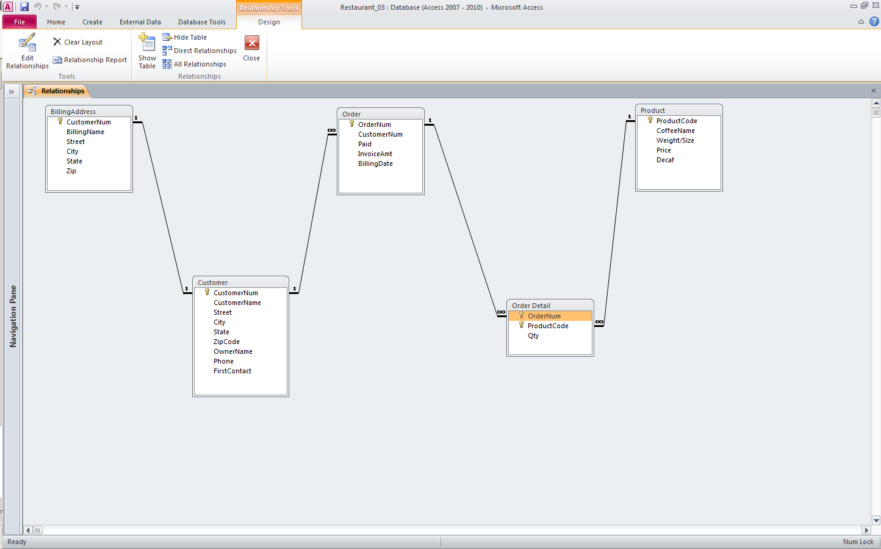
Access Data Model using ERD

Slide 40
What is an Entity Relationship Diagram (ERD)?
ERD is a data modeling technique used in software engineering to produce a conceptual data model of an information system.
So, ERDs illustrate the logical structure of databases.
ERD development using a CASE tool
Powerdesigner by SAP

Slide 41
The Importance of Data Model
Blue print: official documentation
Blue print of house
Employee’s w/o DB knowledge can understand
a data model diagram vs. a list of tables
Used as an effective Communication Tool
Improve interaction among the managers, the designers, and the end users
Independence from a particular DBMS
Network DB, Object-oriented DB, etc.

Slide 42
Data Model (con’t)
The data modeling revolves around discovering and analyzing organizational and users data requirements.
Requirements based on policies, meetings, procedures, system specifications, etc.
Identify what data is important
Identify what data should be maintained
Notes:
7

Slide 43
ERD
The major activity of this phase is identifying entities, attributes, and their relationships to construct model using the Entity Relationship Diagram.
Entity → table
Attribute → column
Relationship → line
Notes:
7

Slide 44
How to find entities?
Entity:
"...anything (people, places, objects, events, etc.) about which we store information (e.g. supplier, machine tool, employee, utility pole, airline seat, etc.).”
Tangible: customer, product
Intangible: order, accounting receivable
Look for singular nouns (beginner)
BUT a proper noun is not a good candidate….

Slide 45
Entity Instance
Entity instance: a single occurrence of an entity.
6 instances
Entity: student
Student ID | Last Name | First Name
2144 | Ganesh | Narayanan
3122 | Taylor | John
3843 | Ram | Sam
9844 | Vikram | Kamal
2837 | Simbu | Arasan
2293 | Legend | Saravanan
instance

Slide 46
How to find attributes?
Attribute:
Attributes are data objects that either identify or describe entities (property of an entity).
In other words, it is a descriptor whose values are associated with individual entities of a specific entity type
The process for identifying attributes is similar except now you want to look for and extract those names that appear to be descriptive noun phrases.

Slide 47
How to find relationships?
Relationship:
Relationships are associations between entities.
Typically, a relationship is indicated by a verb connecting two or more entities.
Employees are assigned to projects
Relationships should be classified in terms of cardinality.
One-to-one, one-to-many, etc.

Slide 48
How to find cardinalities?
Cardinality:
The cardinality is the number of occurrences in one entity which are associated to the number of occurrences in another.
There are three basic cardinalities (degrees of relationship).
one-to-one (1:1), one-to-many (1:M), and many-to-many (M:N)

Slide 49
Identifier
“attributes that uniquely identify entity instances”
Becomes a PK in RDS
Composite identifiers are identifiers that consist of two or more attributes
Identifiers are represented by underlying the name of the attribute(s)
Employee (Employee_ID), student (Student_ID)
Notes:
18

Slide 50
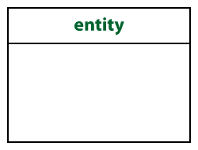
Crow’s Foot Notation
Most Popular notation
Entity:
Represented by a rectangle, with its name on the top. The name is singular (entity) rather than plural (entities).

Slide 51
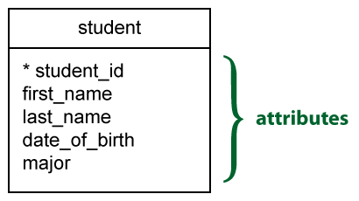
Attributes
Identifiers are represented by underlying the name of the attribute(s)

Slide 52
Basic Cardinality Type
1-to-1 relationship
1-to-M relationship
M-to-N relationship

Slide 53
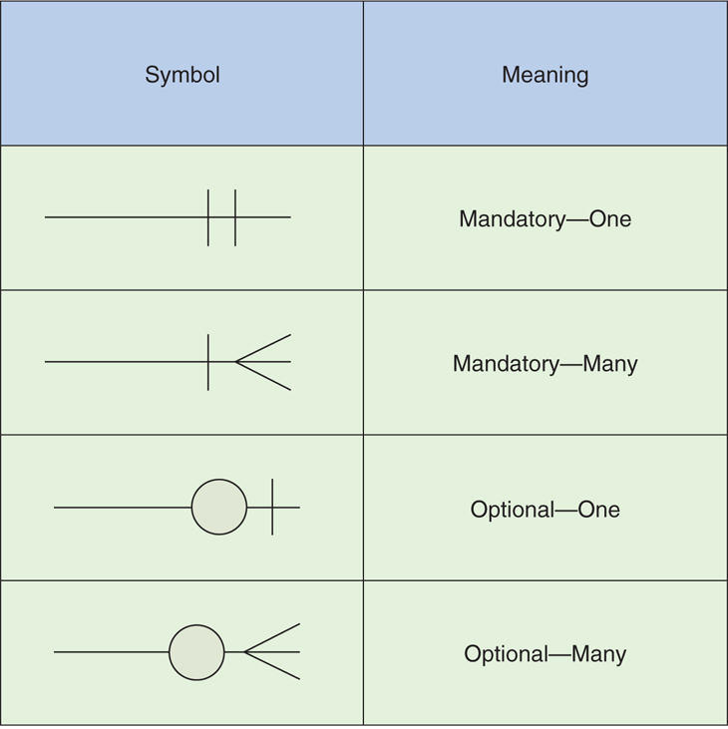
Cardinality con’t

Slide 54
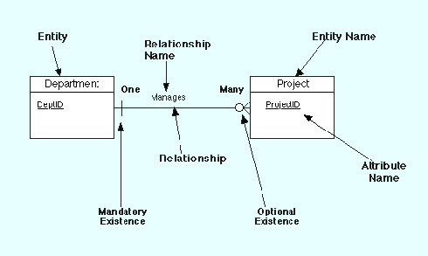
Example Model

Slide 55
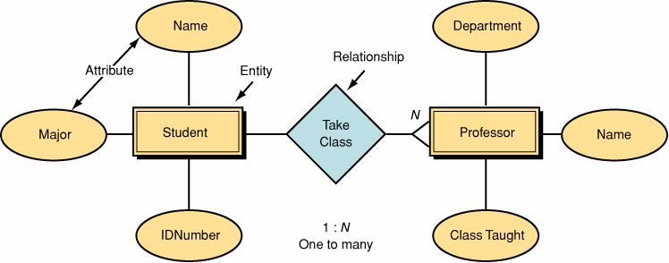
Data Model by Peter Chen’ Notation (first - original)

Slide 56
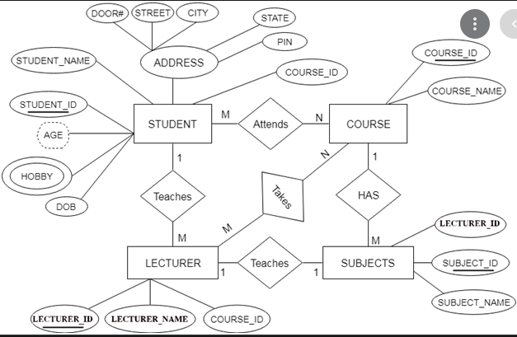
Sample ER Diagram

Slide 57
ERD
ER diagram [ERD] is a visual representation of data based on ER model, and it describes how entities are related to each other in the database.
EER diagram is a visual representation of data, based on EER model that is an extension of the original entity-relationship (ER) model.

Slide 58
ERD
The ER diagram represents the relationship between different entities.
The entities, attributes and relationships are common components of an ER diagram.
An entity is a real-world object. In a School database, there can be entities such as Student, Lecturer, Course etc.
If Student is an entity, the whole dataset of Student is called an entity set. Some entities might depend on another entity. That kind of entity is known as a weak entity.

Slide 59
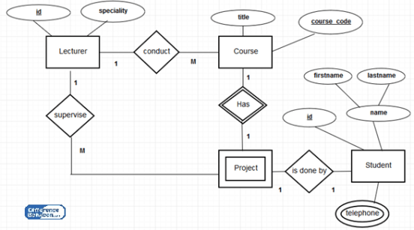
Sample ER Diagram

Slide 60
Three Components in EER
Three concepts added to the existing ER model in the Enhanced ER diagram (EER).
Generalization, Specialization and Aggregation.
In generalization, the lower-level entities can be combined to produce a higher-level entity.
The specialization is the opposite of generalization. In specialization, the high-level entities can be divided into lower-level entities.
Aggregation is a process when the relation between two entities is treated as a single entity.

Slide 61
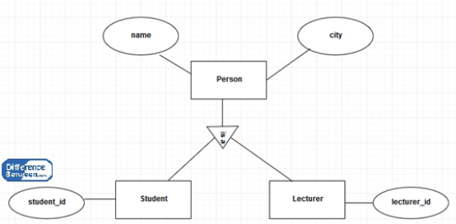
Generalization and Specialization

Slide 62
Generalization and Specialization
The Student and Lecturer entities are Person entities.
When going from bottom to top, generalizes the Student and Lecturer entities to Person entity. It is the bottom up approach.
When going from top to bottom, the Person entity can be further specialized into Student and Lecturer. It is the top down approach.
The name and city attributes of Person belongs to Student entity a Lecturer entity.
The Student entity has its own student_id attribute, and Lecturer entity has its lecturer_id.

Slide 63
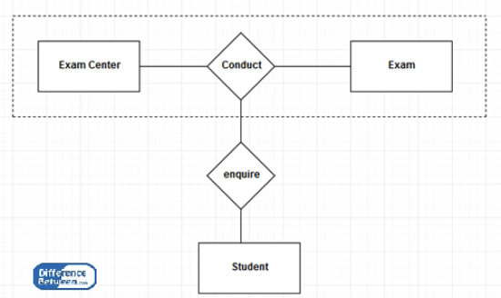
Aggregation

Slide 64
Aggregation
The relationship between Exam Center and Exam together act as an entity.
This whole entity is in a relationship with the Student entity.
When the Student visits the Exam centre, he or she will inquire about both the centre and the exam.
Therefore, when the relation between two entities is treated as a single entity, it is an aggregation.

Slide 65
ER and EER Difference
ER vs EER Diagram
ER diagram is a visual representation of data based on ER model, and it describes how entities are related to each other in the database. | EER diagram is a visual representation of data, based on EER model that is an extension of the original entity-relationship (ER) model.
Model
ER diagram is based on ER model. | EER diagram is based on EER model

Slide 66
Attributes
“Describe detail information about an entity ”
Entity: Employee
Attributes:
Employee-Name
Address (composite)
Phone Extension
Date-Of-Hire
Job-Skill-Code
Salary
Notes:
18

Slide 67
Classes of attributes
Simple attribute
Composite attribute
Derived attributes
Single-valued attribute
Multi-valued attribute
Notes:
5

Slide 68
Simple/Composite attribute
A simple attribute cannot be subdivided.
Examples: Age, Gender, and Marital status
A composite attribute can be further subdivided to yield additional attributes.
Examples:
ADDRESS --→ Street, City, State, Zip
PHONE NUMBER --→ Area code, Exchange number
Notes:
22

Slide 69
Derived attribute
is not physically stored within the database
instead, it is derived by using an algorithm.
Example 1: Late Charge of 2%
MS Access: InvoiceAmt * 0.02
Example 2: AGE can be derived from the date of birth and the current date.
MS Access: int(Date() – Emp_Dob)/365)
Notes:
22

Slide 70
Single-valued attribute
can have only a single (atomic) value.
Examples:
A person can have only one social security number.
A manufactured part can have only one serial number.
A single-valued attribute is not necessarily a simple attribute.
Part No: CA-08-02-189935
Location: CA, Factory#:08, shift#: 02, part#: 189935
Notes:
23

Slide 71
Multi-valued attributes
can have many values.
Examples:
A person may have several college degrees.
A household may have several phones with different numbers
A car color
Notes:
23

Slide 72
Example - “Movie Database”
Entity:
Movie Star
Attributes:
SS#: “123-45-6789” (single-valued)
Cell Phone: “(661)123-4567, (661)234-5678” (multi-valued)
Name: “Harrison Ford” (composite)
Address: “123 Main Str., LA, CA” (composite)
Gender: “Female” (simple)
Age: 24 (derived)

Slide 73
Procedure of ERD
Relatively simple representations of complex real-world data structures
Data modeling is iterative process.
“complete” and “100% error free” model is not possible!
Only “Optimized” model is possible….

Slide 74
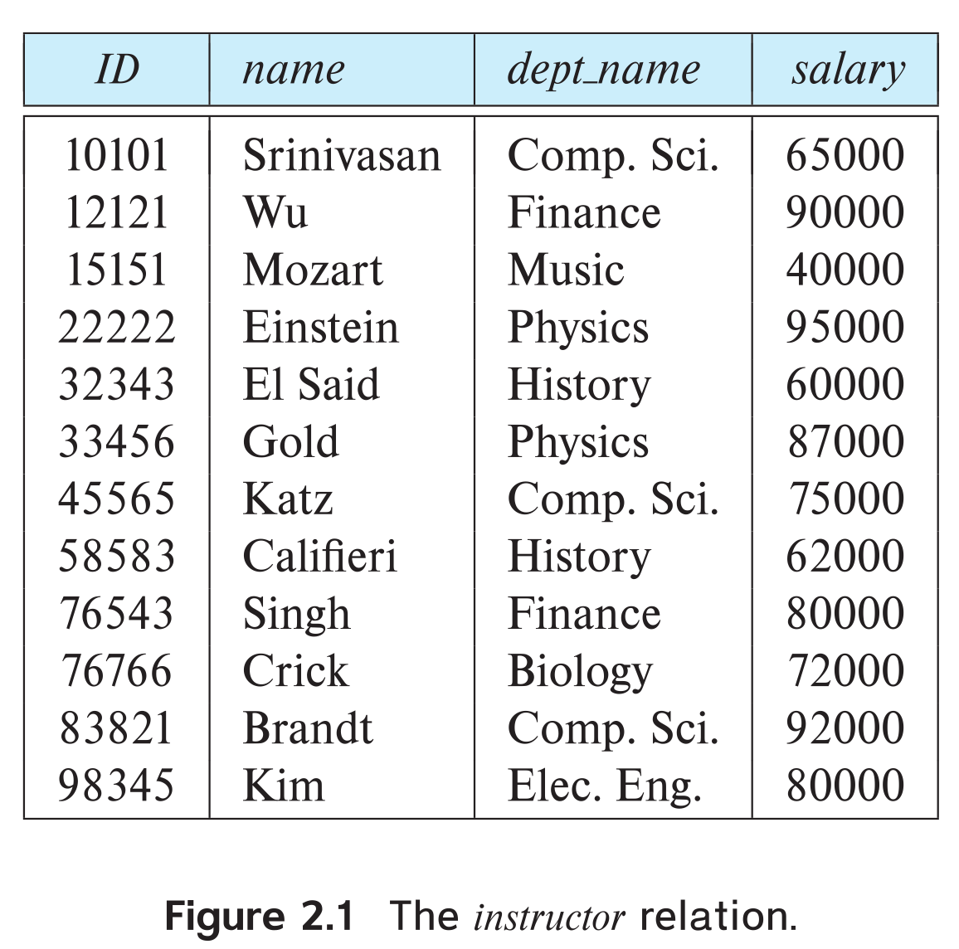
Example of a Instructor Relation
attributes
(or columns)
tuples
(or rows)

Slide 75
Relation Schema and Instance
A₁, A₂, …, A_{n} are attributes
R = (A₁, A₂, …, A_{n} ) is a relation schema
Example:
instructor = (ID, name, dept_name, salary)
A relation instance r defined over schema R is denoted by r (R).
The current values a relation are specified by a table
An element t of relation r is called a tuple and is represented by a row in a table
Notes:
1

Slide 76
Attributes
The set of allowed values for each attribute is called the domain of the attribute
Attribute values are (normally) required to be atomic; that is, indivisible
The special value null is a member of every domain. Indicated that the value is “unknown”
The null value causes complications in the definition of many operations

Slide 77
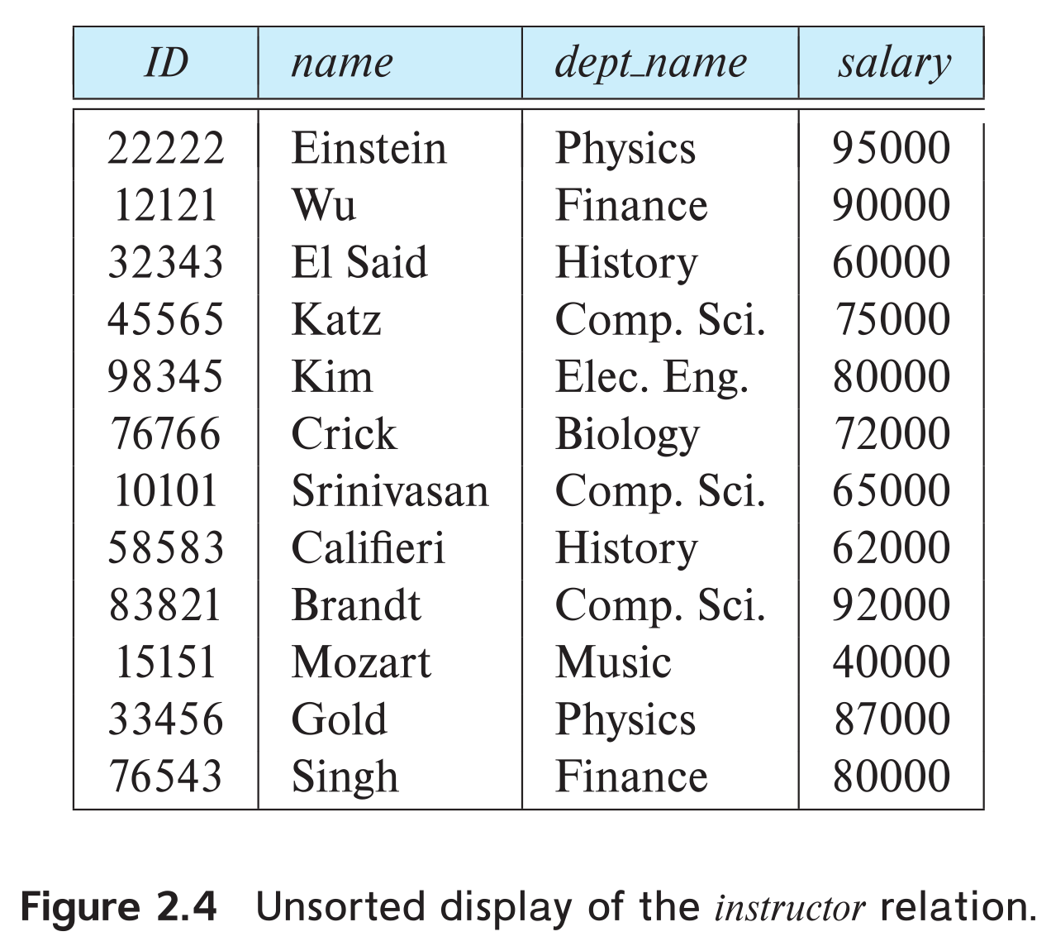
Relations are Unordered
Order of tuples is irrelevant (tuples may be stored in an arbitrary order)
Example: instructor relation with unordered tuples

Slide 78
Database Schema
Database schema -- is the logical structure of the database.
Database instance -- is a snapshot of the data in the database at a given instant in time.
Example:
schema: instructor (ID, name, dept_name, salary)
Instance:

Slide 79
Keys
Let K ⊆ R
K is a superkey of R if values for K are sufficient to identify a unique tuple of each possible relation r(R)
Example: {ID} and {ID,name} are both superkeys of instructor.
Superkey K is a candidate key if K is minimal Example: {ID} is a candidate key for Instructor
One of the candidate keys is selected to be the primary key.
Which one?
Foreign key constraint: Value in one relation must appear in another
Referencing relation
Referenced relation
Example: dept_name in instructor is a foreign key from instructor referencing department

Slide 80
Relational Query Languages
Procedural versus non-procedural, or declarative
“Pure” languages:
Relational algebra
Tuple relational calculus
Domain relational calculus
The above 3 pure languages are equivalent in computing power
We will concentrate in this chapter on relational algebra
Not Turing-machine equivalent
Consists of 6 basic operations

Slide 81
Relational Algebra
A procedural language consisting of a set of operations that take one or two relations as input and produce a new relation as their result.
Six basic operators
select: σ
project: ∏
union: ∪
set difference: –
Cartesian product: x
rename: ρ

Slide 82
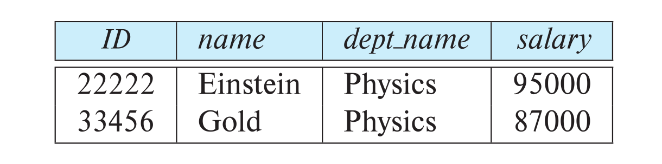
Select Operation
The select operation selects tuples that satisfy a given predicate.
Notation: σ _{p} (r)
p is called the selection predicate
Example: select those tuples of the instructor relation where the instructor is in the “Physics” department.
Query
σ _{dept_name=“Physics”} (instructor)
Result

Slide 83
Select Operation (Cont.)
We allow comparisons using
=, ≠, >, ≥. <. ≤
in the selection predicate.
We can combine several predicates into a larger predicate by using the connectives:
∧ (and), ∨ (or), ¬ (not)
Example: Find the instructors in Physics with a salary greater $90,000, we write:
σ _{dept_name=“Physics”} ∧ _{salary >} _{90,000} (instructor)
The select predicate may include comparisons between two attributes.
Example, find all departments whose name is the same as their building name:
σ _{dept_name=building} (department)

Slide 84
Project Operation
A unary operation that returns its argument relation, with certain attributes left out.
Notation:
∏ _{A1,A2,A3 ….Ak} (r)
where A₁, A₂, …, A_{k} are attribute names and r is a relation name.
The result is defined as the relation of k columns obtained by erasing the columns that are not listed
Duplicate rows removed from result, since relations are sets

Slide 85
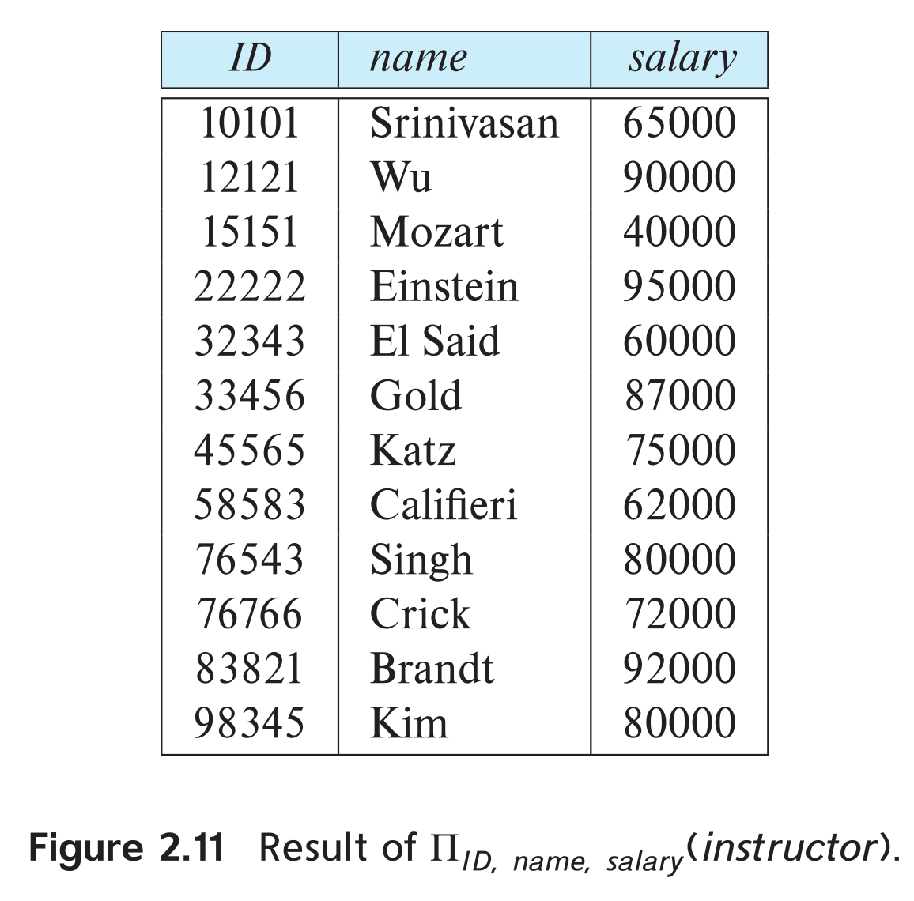
Project Operation Example
Example: eliminate the dept_name attribute of instructor
Query: ∏_{ID, name, salary} (instructor)
Result:

Slide 86
Composition of Relational Operations
The result of a relational-algebra operation is relation and therefore of relational-algebra operations can be composed together into a relational-algebra expression.
Consider the query -- Find the names of all instructors in the Physics department.
∏_{name}(σ _{dept_name} _{=“Physics”} (instructor))
Instead of giving the name of a relation as the argument of the projection operation, we give an expression that evaluates to a relation.

Slide 87
Cartesian-Product Operation
The Cartesian-product operation (denoted by X) allows us to combine information from any two relations.
Example: the Cartesian product of the relations instructor and teaches is written as:
instructor X teaches
We construct a tuple of the result out of each possible pair of tuples: one from the instructor relation and one from the teaches relation (see next slide)
Since the instructor ID appears in both relations we distinguish between these attribute by attaching to the attribute the name of the relation from which the attribute originally came.
instructor.ID
teaches.ID

Slide 88
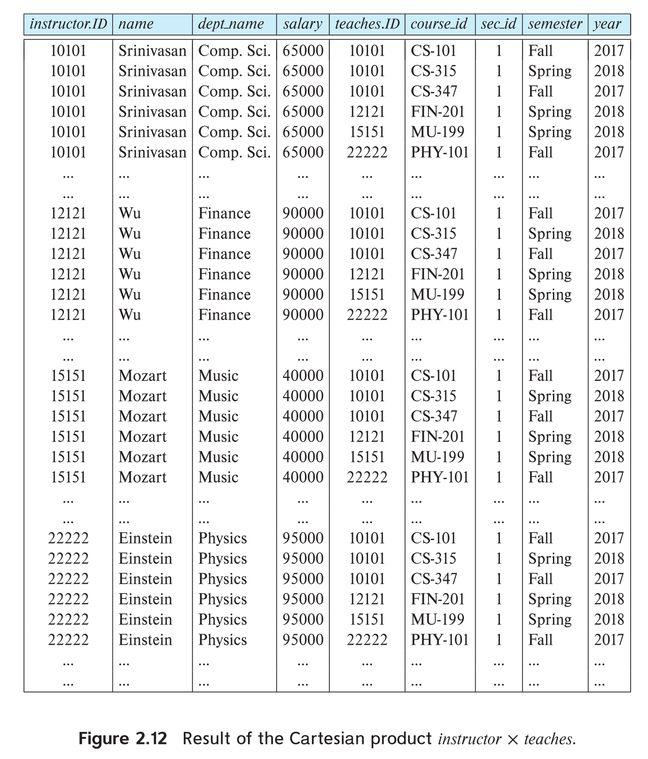
The instructor X teaches table

Slide 89
Join Operation
The Cartesian-Product
instructor X teaches
associates every tuple of instructor with every tuple of teaches.
Most of the resulting rows have information about instructors who did NOT teach a particular course.
To get only those tuples of “instructor X teaches “ that pertain to instructors and the courses that they taught, we write:
σ _{instructor.id = teaches.id} (instructor x teaches )
We get only those tuples of “instructor X teaches” that pertain to instructors and the courses that they taught.
The result of this expression, shown in the next slide

Slide 90
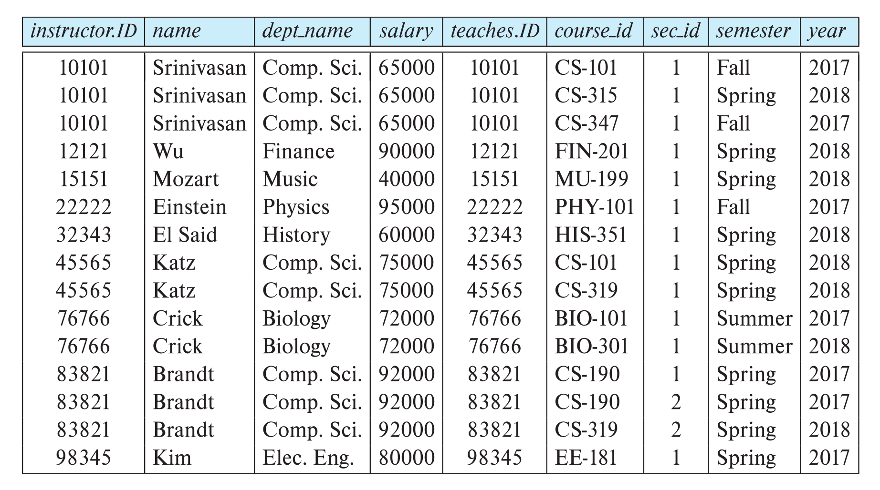
Join Operation (Cont.)
The table corresponding to:
σ _{instructor.id = teaches.id} (instructor x teaches))

Slide 91
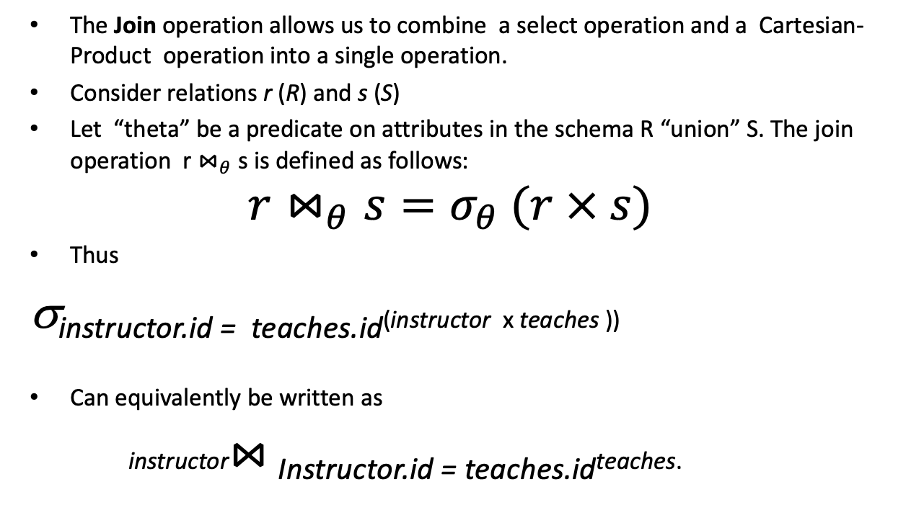
Join Operation (Cont.)
The Join operation allows us to combine a select operation and a Cartesian-Product operation into a single operation.
Consider relations r (R) and s (S)
Let “theta” be a predicate on attributes in the schema R “union” S. The join operation r $⋈_{θ}$ s is defined as follows:
$$r⋈_{θ}s=σ_{θ} (r × s)$$
Thus
σ_{instructor.id = teaches.id}(instructor x teaches ))
Can equivalently be written as
instructor$⋈_{ }$_{Instructor.id = teaches.id}teaches.

Slide 92
Union Operation
The union operation allows us to combine two relations
Notation: r ∪ s
For r ∪ s to be valid.
1. r, s must have the same arity (same number of attributes)
2. The attribute domains must be compatible (example: 2nd
column of r deals with the same type of values as does the
2nd column of s)
Example: to find all courses taught in the Fall 2017 semester, or in the Spring 2018 semester, or in both ∏_{course_id} (σ _{semester=“Fall” Λ year=2017} (section)) ∪ ∏_{course_id} (σ _{semester=“Spring” Λ year=2018} (section))

Slide 93
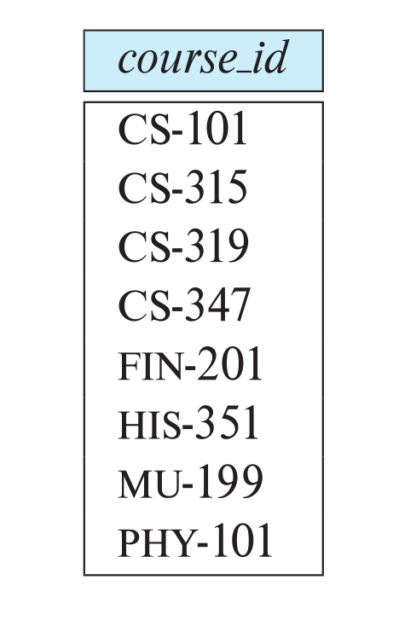
Union Operation (Cont.)
Result of: ∏_{course_id} (σ _{semester=“Fall” Λ year=2017} (section)) ∪ ∏_{course_id} (σ _{semester=“Spring” Λ year=2018} (section))

Slide 94

Set-Intersection Operation
The set-intersection operation allows us to find tuples that are in both the input relations.
Notation: r ∩ s
Assume:
r, s have the same arity
attributes of r and s are compatible
Example: Find the set of all courses taught in both the Fall 2017 and the Spring 2018 semesters.
∏_{course_id} (σ _{semester=“Fall” Λ year=2017} (section)) ∩ ∏_{course_id} (σ _{semester=“Spring” Λ year=2018} (section))
Result

Slide 95

Set Difference Operation
The set-difference operation allows us to find tuples that are in one relation but are not in another.
Notation r – s
Set differences must be taken between compatible relations.
r and s must have the same arity
attribute domains of r and s must be compatible
Example: to find all courses taught in the Fall 2017 semester, but not in the Spring 2018 semester ∏_{course_id} (σ _{semester=“Fall” Λ year=2017} (section)) − ∏_{course_id} (σ _{semester=“Spring” Λ year=2018} (section))

Slide 96
The Assignment Operation
It is convenient at times to write a relational-algebra expression by assigning parts of it to temporary relation variables.
The assignment operation is denoted by ← and works like assignment in a programming language.
Example: Find all instructor in the “Physics” and Music department. Physics ← σ _{dept_name=“Physics”} (instructor)
Music ← σ _{dept_name=“Music”} (instructor)
Physics ∪ Music
With the assignment operation, a query can be written as a sequential program consisting of a series of assignments followed by an expression whose value is displayed as the result of the query.

Slide 97
The Rename Operation
The results of relational-algebra expressions do not have a name that we can use to refer to them. The rename operator, ρ , is provided for that purpose
The expression:
ρ_{x} (E)
returns the result of expression E under the name x
Another form of the rename operation:
ρ_{x(A1,A2, .. An)} (E)

Slide 98
Equivalent Queries
There is more than one way to write a query in relational algebra.
Example: Find information about courses taught by instructors in the Physics department with salary greater than 90,000
Query 1
σ _{dept_name=“Physics”} ∧ _{salary > 90,000} (instructor)
Query 2
σ _{dept_name=“Physics”} (σ _{salary > 90.000} (instructor))
The two queries are not identical; they are, however, equivalent -- they give the same result on any database.

Slide 99
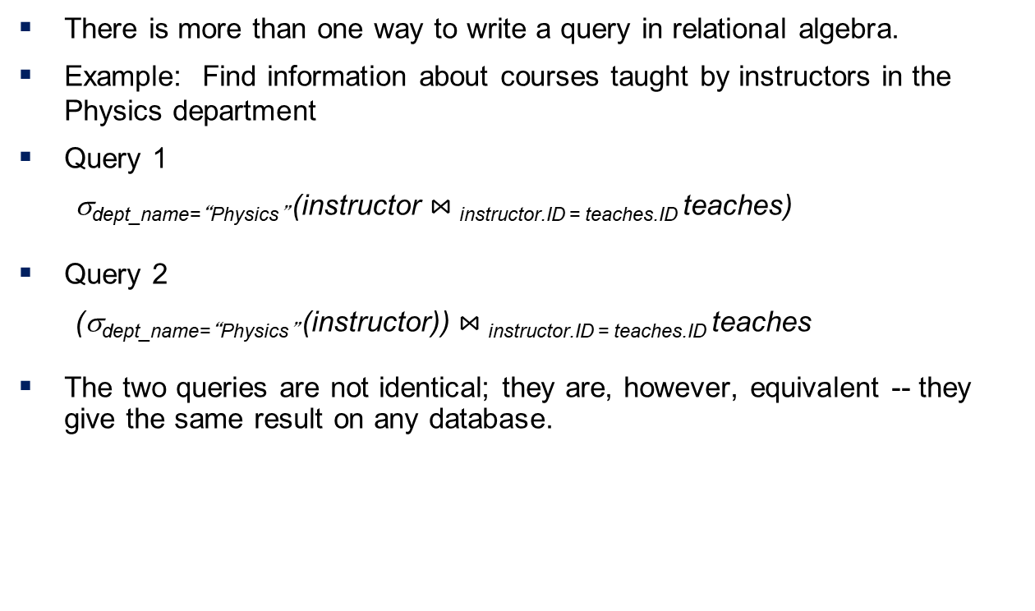
Equivalent Queries
There is more than one way to write a query in relational algebra.
Example: Find information about courses taught by instructors in the Physics department
Query 1
σ_{dept_name=“Physics”} (instructor$⋈_{ }$_{instructor.ID = teaches.ID}teaches)
Query 2
(σ_{dept_name=“Physics”} (instructor))$⋈_{ }$_{instructor.ID = teaches.ID}teaches
The two queries are not identical; they are, however, equivalent -- they give the same result on any database.

Slide 100
Query Optimization

Slide 101
Query Optimization
Query optimization is the overall process of choosing the most efficient means of executing a SQL statement.
SQL is a nonprocedural language, so the optimizer is free to merge, reorganize, and process in any order.
The database optimizes each SQL statement based on statistics collected about the accessed data.

Slide 102
Principles in Query Optimization
Understand how your database is executing your query
Retrieve as little data as possible
Store intermediate results
Use Index, Aggregate Table

Slide 103
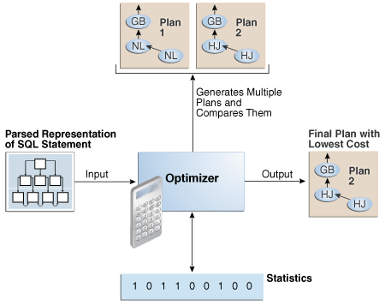
Execution Plans

Slide 104
Query Block
The input to the optimizer is a parsed representation of a SQL statement.
Each SELECT block in the original SQL statement is represented internally by a query block.
A query block can be a top-level statement, subquery, or unmerged view.

Slide 105
Sample Query
SELECT first_name, last_name FROM hr.employees WHERE department_id IN (SELECT department_id FROM hr.departments WHERE location_id = 1800);

Slide 106
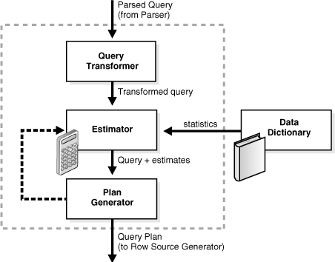
Optimizer Components

Slide 107
Optimizer Operations
Phase | Operation | Description | To Learn More
1 | Query Transformer | The optimizer determines whether it is helpful to change the form of the query so that the optimizer can generate a better execution plan. | "Query Transformer"
2 | Estimator | The optimizer estimates the cost of each plan based on statistics in the data dictionary. | "Estimator"
3 | Plan Generator | The optimizer compares the costs of plans and chooses the lowest-cost plan, known as the execution plan, to pass to the row source generator. | "Plan Generator"

Slide 108
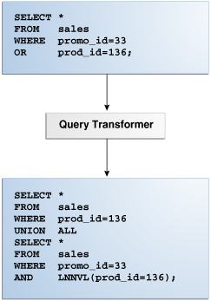
Query Transformer
the query transformer determines whether it is advantageous to rewrite the original SQL statement into a semantically equivalent SQL statement with a lower cost.

Slide 109
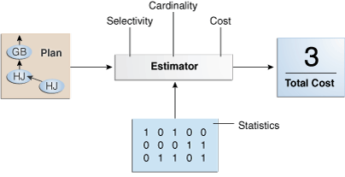
Estimator
The estimator is the component of the optimizer that determines the overall cost of a given execution plan.
Selectivity, Cardinality, Cost

Slide 110
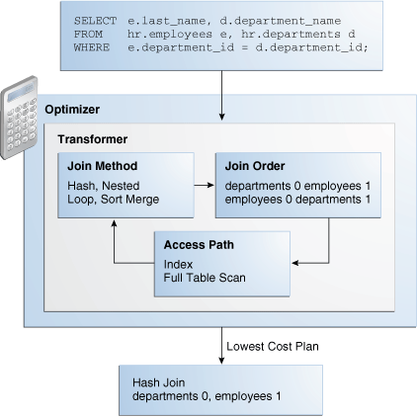
Plan Generator

Slide 111
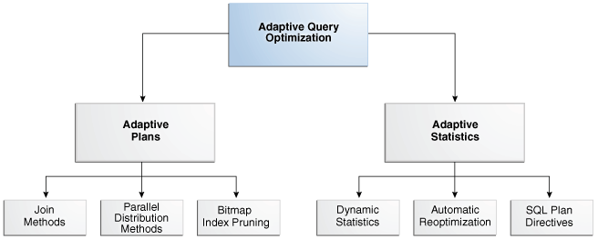
Adaptive Query Optimization
Adaptive query optimization enables the optimizer to make run-time adjustments to execution plans and discover additional information that can lead to better statistics.

Slide 112
History
IBM Sequel language developed as part of System R project at the IBM San Jose Research Laboratory
Renamed Structured Query Language (SQL)
ANSI and ISO standard SQL:
SQL-86
SQL-89
SQL-92
SQL:1999 (language name became Y2K compliant!)
SQL:2003
Commercial systems offer most, if not all, SQL-92 features, plus varying feature sets from later standards and special proprietary features.
Not all examples here may work on your particular system.

Slide 113
SQL Parts
DML -- provides the ability to query information from the database and to insert tuples into, delete tuples from, and modify tuples in the database.
integrity – the DDL includes commands for specifying integrity constraints.
View definition -- The DDL includes commands for defining views.
Transaction control –includes commands for specifying the beginning and ending of transactions.
Embedded SQL and dynamic SQL -- define how SQL statements can be embedded within general-purpose programming languages.
Authorization – includes commands for specifying access rights to relations and views.

Slide 114
Data Definition Language
The SQL data-definition language (DDL) allows the specification of information about relations, including:
The schema for each relation.
The type of values associated with each attribute.
The Integrity constraints
The set of indices to be maintained for each relation.
Security and authorization information for each relation.
The physical storage structure of each relation on disk.

Slide 115
Domain Types in SQL
char(n). Fixed length character string, with user-specified length n.
varchar(n). Variable length character strings, with user-specified maximum length n.
int. Integer (a finite subset of the integers that is machine-dependent).
smallint. Small integer (a machine-dependent subset of the integer domain type).
numeric(p,d). Fixed point number, with user-specified precision of p digits, with d digits to the right of decimal point. (ex., numeric(3,1), allows 44.5 to be stores exactly, but not 444.5 or 0.32)
real, double precision. Floating point and double-precision floating point numbers, with machine-dependent precision.
float(n). Floating point number, with user-specified precision of at least n digits.
More are covered in Chapter 4.

Slide 116
Create Table Construct
An SQL relation is defined using the create table command:
create table r
(A₁ D₁, A₂ D₂, ..., A_{n} D_{n}, (integrity-constraint₁), ..., (integrity-constraint_{k}))
r is the name of the relation
each A_{i} is an attribute name in the schema of relation r
D_{i} is the data type of values in the domain of attribute A_{i}
Example:
create table instructor ( ID char(5), name varchar(20), dept_name varchar(20), salary numeric(8,2))

Slide 117
Integrity Constraints in Create Table
Types of integrity constraints
primary key (A₁, ..., A_{n} )
foreign key (A_{m}, ..., A_{n} ) references r
not null
SQL prevents any update to the database that violates an integrity constraint.
Example:
create table instructor ( ID char(5), name varchar(20) not null, dept_name varchar(20), salary numeric(8,2), primary key (ID), foreign key (dept_name) references department);

Slide 118
And a Few More Relation Definitions
create table student ( ID varchar(5), name varchar(20) not null, dept_name varchar(20), tot_cred numeric(3,0), primary key (ID),
foreign key (dept_name) references department);
create table takes ( ID varchar(5), course_id varchar(8), sec_id varchar(8), semester varchar(6), year numeric(4,0), grade varchar(2),
primary key (ID, course_id, sec_id, semester, year) ,
foreign key (ID) references student, foreign key (course_id, sec_id, semester, year) references section);

Slide 119
And more still
create table course ( course_id varchar(8), title varchar(50), dept_name varchar(20), credits numeric(2,0),
primary key (course_id),
foreign key (dept_name) references department);

Slide 120
Updates to tables
Insert
insert into instructor values ('10211', 'Smith', 'Biology', 66000);
Delete
Remove all tuples from the student relation
delete from student
Drop Table
drop table r
Alter
alter table r add A D
where A is the name of the attribute to be added to relation r and D is the domain of A.
All exiting tuples in the relation are assigned null as the value for the new attribute.
alter table r drop A
where A is the name of an attribute of relation r
Dropping of attributes not supported by many databases.

Slide 121
Basic Query Structure
A typical SQL query has the form: select A₁, A₂, ..., A_{n} from r₁, r₂, ..., r_{m} where P
A_{i} represents an attribute
R_{i} represents a relation
P is a predicate.
The result of an SQL query is a relation.
Notes:
2

Slide 122
The select Clause
The select clause lists the attributes desired in the result of a query
corresponds to the projection operation of the relational algebra
Example: find the names of all instructors: select name from instructor
NOTE: SQL names are case insensitive (i.e., you may use upper- or lower-case letters.)
E.g., Name ≡ NAME ≡ name
Some people use upper case wherever we use bold font.
Notes:
3

Slide 123
The select Clause (Cont.)
SQL allows duplicates in relations as well as in query results.
To force the elimination of duplicates, insert the keyword distinct after select.
Find the department names of all instructors, and remove duplicates
select distinct dept_name from instructor
The keyword all specifies that duplicates should not be removed.
select all dept_name from instructor
Notes:
4

Slide 124
The select Clause (Cont.)
An asterisk in the select clause denotes “all attributes”
select * from instructor
An attribute can be a literal with no from clause
select '437'
Results is a table with one column and a single row with value “437”
Can give the column a name using:
select '437' as FOO
An attribute can be a literal with from clause
select 'A' from instructor
Result is a table with one column and N rows (number of tuples in the instructors table), each row with value “A”
Notes:
5

Slide 125
The select Clause (Cont.)
The select clause can contain arithmetic expressions involving the operation, +, –, ∗, and /, and operating on constants or attributes of tuples.
The query:
select ID, name, salary/12 from instructor
would return a relation that is the same as the instructor relation, except that the value of the attribute salary is divided by 12.
Can rename “salary/12” using the as clause:
select ID, name, salary/12 as monthly_salary
Notes:
5

Slide 126
The where Clause
The where clause specifies conditions that the result must satisfy
Corresponds to the selection predicate of the relational algebra.
To find all instructors in Comp. Sci. dept
select name from instructor where dept_name = 'Comp. Sci.'
SQL allows the use of the logical connectives and, or, and not
The operands of the logical connectives can be expressions involving the comparison operators <, <=, >, >=, =, and <>.
Comparisons can be applied to results of arithmetic expressions
To find all instructors in Comp. Sci. dept with salary > 70000
select name from instructor where dept_name = 'Comp. Sci.' and salary > 70000
Notes:
6

Slide 127
The from Clause
The from clause lists the relations involved in the query
Corresponds to the Cartesian product operation of the relational algebra.
Find the Cartesian product instructor X teaches
select ∗ from instructor, teaches
generates every possible instructor – teaches pair, with all attributes from both relations.
For common attributes (e.g., ID), the attributes in the resulting table are renamed using the relation name (e.g., instructor.ID)
Cartesian product not very useful directly, but useful combined with where-clause condition (selection operation in relational algebra).
Notes:
8

Slide 128
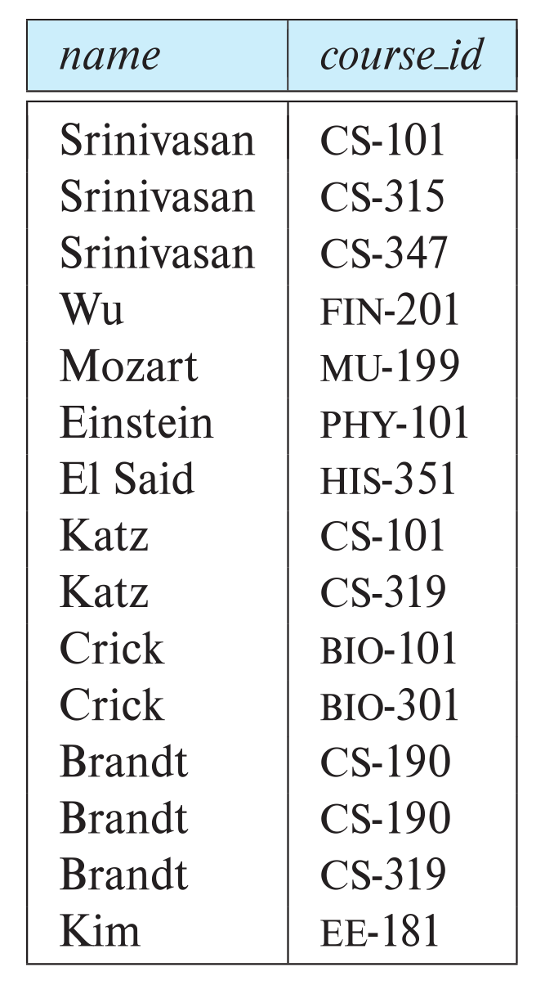
Examples
Find the names of all instructors who have taught some course and the course_id
select name, course_id from instructor , teaches where instructor.ID = teaches.ID
Find the names of all instructors in the Art department who have taught some course and the course_id
select name, course_id from instructor , teaches where instructor.ID = teaches.ID and instructor. dept_name = 'Art'
Notes:
9

Slide 129
The Rename Operation
The SQL allows renaming relations and attributes using the as clause:
old-name as new-name
Find the names of all instructors who have a higher salary than some instructor in 'Comp. Sci'.
select distinct T.name from instructor as T, instructor as S where T.salary > S.salary and S.dept_name = 'Comp. Sci.’
Keyword as is optional and may be omitted instructor as T ≡ instructor T
Notes:
9

Slide 130
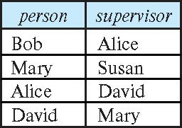
Self Join Example
Relation emp-super
Find the supervisor of “Bob”
Find the supervisor of the supervisor of “Bob”
Can you find ALL the supervisors (direct and indirect) of “Bob”?
Notes:
9

Slide 131
String Operations
SQL includes a string-matching operator for comparisons on character strings. The operator like uses patterns that are described using two special characters:
percent ( % ). The % character matches any substring.
underscore ( _ ). The _ character matches any character.
Find the names of all instructors whose name includes the substring “dar”.
select name from instructor where name like '%dar%'
Match the string “100%”
like '100 \%' escape '\'
in that above we use backslash (\) as the escape character.

Slide 132
String Operations (Cont.)
Patterns are case sensitive.
Pattern matching examples:
'Intro%' matches any string beginning with “Intro”.
'%Comp%' matches any string containing “Comp” as a substring.
'_ _ _' matches any string of exactly three characters.
'_ _ _ %' matches any string of at least three characters.
SQL supports a variety of string operations such as
concatenation (using “||”)
converting from upper to lower case (and vice versa)
finding string length, extracting substrings, etc.

Slide 133
Ordering the Display of Tuples
List in alphabetic order the names of all instructors
select distinct name from instructor order by name
We may specify desc for descending order or asc for ascending order, for each attribute; ascending order is the default.
Example: order by name desc
Can sort on multiple attributes
Example: order by dept_name, name

Slide 134
Where Clause Predicates
SQL includes a between comparison operator
Example: Find the names of all instructors with salary between $90,000 and $100,000 (that is, ≥ $90,000 and ≤ $100,000)
select name from instructor where salary between 90000 and 100000
Tuple comparison
select name, course_id from instructor, teaches where (instructor.ID, dept_name) = (teaches.ID, 'Biology');
Notes:
7

Slide 135
Set Operations
Find courses that ran in Fall 2017 or in Spring 2018
(select course_id from section where sem = 'Fall' and year = 2017) union (select course_id from section where sem = 'Spring' and year = 2018)
Find courses that ran in Fall 2017 and in Spring 2018
(select course_id from section where sem = 'Fall' and year = 2017) intersect (select course_id from section where sem = 'Spring' and year = 2018)
Find courses that ran in Fall 2017 but not in Spring 2018
(select course_id from section where sem = 'Fall' and year = 2017) except (select course_id from section where sem = 'Spring' and year = 2018)

Slide 136
Set Operations (Cont.)
Set operations union, intersect, and except
Each of the above operations automatically eliminates duplicates
To retain all duplicates use the
union all,
intersect all
except all.

Slide 137
Null Values
It is possible for tuples to have a null value, denoted by null, for some of their attributes
null signifies an unknown value or that a value does not exist.
The result of any arithmetic expression involving null is null
Example: 5 + null returns null
The predicate is null can be used to check for null values.
Example: Find all instructors whose salary is null.
select name from instructor where salary is null
The predicate is not null succeeds if the value on which it is applied is not null.

Slide 138
Null Values (Cont.)
SQL treats as unknown the result of any comparison involving a null value (other than predicates is null and is not null).
Example: 5 < null or null <> null or null = null
The predicate in a where clause can involve Boolean operations (and, or, not); thus the definitions of the Boolean operations need to be extended to deal with the value unknown.
and : (true and unknown) = unknown, (false and unknown) = false, (unknown and unknown) = unknown
or: (unknown or true) = true, (unknown or false) = unknown (unknown or unknown) = unknown
Result of where clause predicate is treated as false if it evaluates to unknown

Slide 139
Aggregate Functions
These functions operate on the multiset of values of a column of a relation, and return a value
avg: average value min: minimum value max: maximum value sum: sum of values count: number of values

Slide 140
Aggregate Functions Examples
Find the average salary of instructors in the Computer Science department
select avg (salary) from instructor where dept_name= 'Comp. Sci.';
Find the total number of instructors who teach a course in the Spring 2018 semester
select count (distinct ID) from teaches where semester = 'Spring' and year = 2018;
Find the number of tuples in the course relation
select count (*) from course;

Slide 141
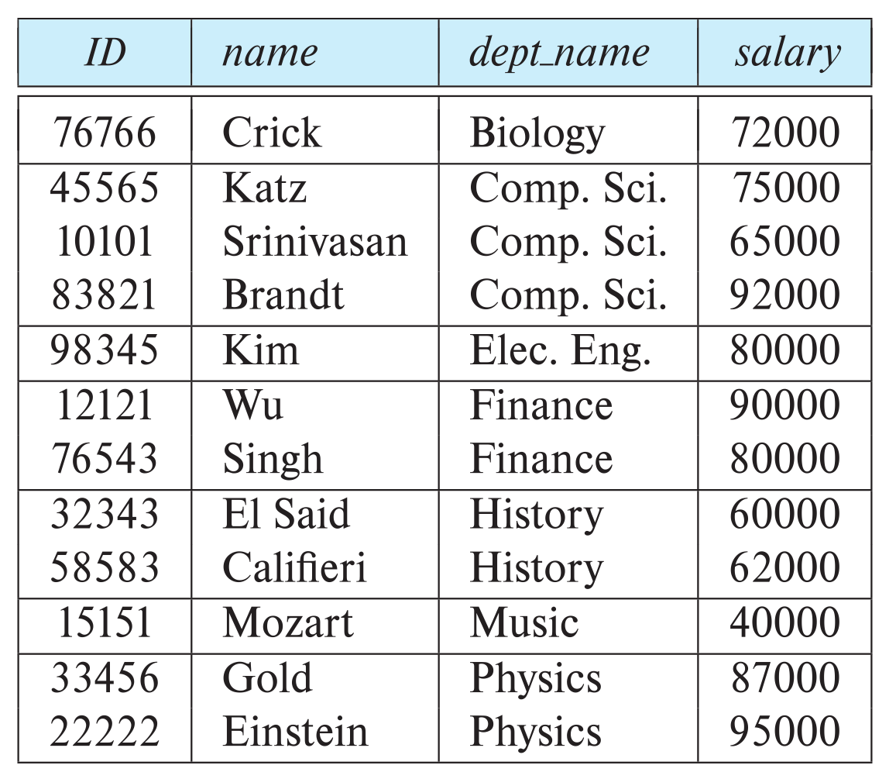
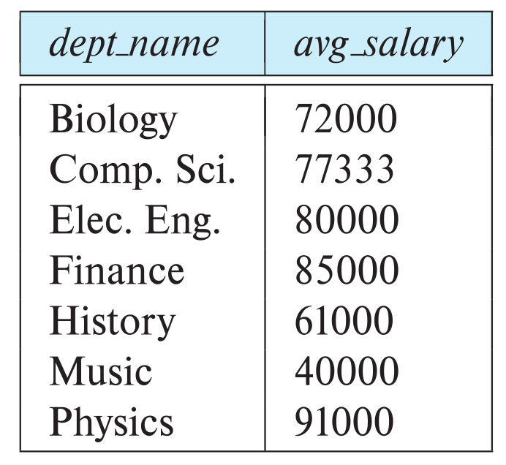
Aggregate Functions – Group By
Find the average salary of instructors in each department
select dept_name, avg (salary) as avg_salary from instructor group by dept_name;

Slide 142
Aggregation (Cont.)
Attributes in select clause outside of aggregate functions must appear in group by list
/* erroneous query */ select dept_name, ID, avg (salary) from instructor group by dept_name;

Slide 143
Aggregate Functions – Having Clause
Find the names and average salaries of all departments whose average salary is greater than 42000
Note: predicates in the having clause are applied after the formation of groups whereas predicates in the where clause are applied before forming groups
select dept_name, avg (salary) as avg_salary
from instructor
group by dept_name
having avg (salary) > 42000;

Slide 144
Nested Subqueries
SQL provides a mechanism for the nesting of subqueries. A subquery is a select-from-where expression that is nested within another query.
The nesting can be done in the following SQL query select A₁, A₂, ..., A_{n} from r₁, r₂, ..., r_{m} where P
as follows:
From clause: r_{i} can be replaced by any valid subquery
Where clause: P can be replaced with an expression of the form:
B <operation> (subquery)
B is an attribute and <operation> to be defined later.
Select clause:
A_{i} can be replaced be a subquery that generates a single value.

Slide 145
Set Membership

Slide 146
Set Membership
Find courses offered in Fall 2017 and in Spring 2018
Find courses offered in Fall 2017 but not in Spring 2018
select distinct course_id
from section
where semester = 'Fall' and year= 2017 and course_id in (select course_id
from section
where semester = 'Spring' and year= 2018);
select distinct course_id
from section
where semester = 'Fall' and year= 2017 and course_id not in (select course_id
from section
where semester = 'Spring' and year= 2018);

Slide 147
Set Membership (Cont.)
Name all instructors whose name is neither “Mozart” nor Einstein”
select distinct name
from instructor
where name not in ('Mozart', 'Einstein')
Find the total number of (distinct) students who have taken course sections taught by the instructor with ID 10101
Note: Above query can be written in a much simpler manner. The formulation above is simply to illustrate SQL features
select count (distinct ID)
from takes
where (course_id, sec_id, semester, year) in (select course_id, sec_id, semester, year
from teaches
where teaches.ID= 10101);

Slide 148
Set Comparison

Slide 149
Set Comparison – “some” Clause
Find names of instructors with salary greater than that of some (at least one) instructor in the Biology department.
Same query using > some clause
select distinct T.name
from instructor as T, instructor as S
where T.salary > S.salary and S.dept name = 'Biology';
select name
from instructor
where salary > some (select salary
from instructor
where dept name = 'Biology');

Slide 150
Definition of “some” Clause
F <comp> some r ⇔ ∃ t ∈ r such that (F <comp> t ) Where <comp> can be: <, ≤, >, =, ≠
0
(5 < some
5
) = true
(read: 5 < some tuple in the relation)
6
0
(5 < some
5
) = false
0
(5 = some
) = true
5
0
(5 ≠ some
5
) = true (since 0 ≠ 5)
(= some) ≡ in
However, (≠ some) ≡ not in

Slide 151
Set Comparison – “all” Clause
Find the names of all instructors whose salary is greater than the salary of all instructors in the Biology department.
select name
from instructor
where salary > all (select salary
from instructor
where dept name = 'Biology');

Slide 152
Definition of “all” Clause
F <comp> all r ⇔ ∀ t ∈ r (F <comp> t)
0
(5 < all
5
) = false
6
6
(5 < all
) = true
10
4
(5 = all
) = false
5
4
(5 ≠ all
) = true (since 5 ≠ 4 and 5 ≠ 6)
6
(≠ all) ≡ not in
However, (= all) ≡ in

Slide 153
Test for Empty Relations
The exists construct returns the value true if the argument subquery is nonempty.
exists r ⇔ r ≠ Ø
not exists r ⇔ r = Ø

Slide 154
Use of “exists” Clause
Yet another way of specifying the query “Find all courses taught in both the Fall 2017 semester and in the Spring 2018 semester”
select course_id from section as S where semester = 'Fall' and year = 2017 and exists (select * from section as T where semester = 'Spring' and year= 2018 and S.course_id = T.course_id);
Correlation name – variable S in the outer query
Correlated subquery – the inner query

Slide 155
Use of “not exists” Clause
Find all students who have taken all courses offered in the Biology department.
Note that X – Y = Ø ⇔ X ⊆ Y
Note: Cannot write this query using = all and its variants
select distinct S.ID, S.name
from student as S
where not exists ( (select course_id
from course
where dept_name = 'Biology')
except
(select T.course_id
from takes as T
where S.ID = T.ID));
First nested query lists all courses offered in Biology
Second nested query lists all courses a particular student took

Slide 156
Test for Absence of Duplicate Tuples
The unique construct tests whether a subquery has any duplicate tuples in its result.
The unique construct evaluates to “true” if a given subquery contains no duplicates .
Find all courses that were offered at most once in 2017
select T.course_id from course as T where unique ( select R.course_id from section as R where T.course_id= R.course_id and R.year = 2017);

Slide 157
Subqueries in the From Clause

Slide 158
Subqueries in the Form Clause
SQL allows a subquery expression to be used in the from clause
Find the average instructors’ salaries of those departments where the average salary is greater than $42,000.”
select dept_name, avg_salary from ( select dept_name, avg (salary) as avg_salary from instructor group by dept_name) where avg_salary > 42000;
Note that we do not need to use the having clause
Another way to write above query
select dept_name, avg_salary from ( select dept_name, avg (salary) from instructor group by dept_name)
as dept_avg (dept_name, avg_salary)
where avg_salary > 42000;

Slide 159
With Clause
The with clause provides a way of defining a temporary relation whose definition is available only to the query in which the with clause occurs.
Find all departments with the maximum budget with max_budget (value) as (select max(budget) from department) select department.name from department, max_budget where department.budget = max_budget.value;

Slide 160
Complex Queries using With Clause
Find all departments where the total salary is greater than the average of the total salary at all departments
with dept _total (dept_name, value) as
(select dept_name, sum(salary)
from instructor
group by dept_name),
dept_total_avg(value) as
(select avg(value)
from dept_total)
select dept_name
from dept_total, dept_total_avg
where dept_total.value > dept_total_avg.value;

Slide 161
Scalar Subquery
Scalar subquery is one which is used where a single value is expected
List all departments along with the number of instructors in each department
select dept_name, ( select count(*) from instructor where department.dept_name = instructor.dept_name) as num_instructors from department;
Runtime error if subquery returns more than one result tuple

Slide 162
Modification of the Database
Deletion of tuples from a given relation.
Insertion of new tuples into a given relation
Updating of values in some tuples in a given relation

Slide 163
Deletion
Delete all instructors
delete from instructor
Delete all instructors from the Finance department delete from instructor where dept_name= 'Finance’;
Delete all tuples in the instructor relation for those instructors associated with a department located in the Watson building.
delete from instructor where dept name in (select dept name from department where building = 'Watson');

Slide 164
Deletion (Cont.)
Delete all instructors whose salary is less than the average salary of instructors
Problem: as we delete tuples from instructor, the average salary changes
Solution used in SQL:
First, compute avg (salary) and find all tuples to delete
Next, delete all tuples found above (without recomputing avg or retesting the tuples)
delete from instructor
where salary < (select avg (salary)
from instructor);

Slide 165
Insertion
Add a new tuple to course
insert into course values ('CS-437', 'Database Systems', 'Comp. Sci.', 4);
or equivalently
insert into course (course_id, title, dept_name, credits) values ('CS-437', 'Database Systems', 'Comp. Sci.', 4);
Add a new tuple to student with tot_creds set to null
insert into student values ('3003', 'Green', 'Finance', null);

Slide 166
Insertion (Cont.)
Make each student in the Music department who has earned more than 144 credit hours an instructor in the Music department with a salary of $18,000.
insert into instructor select ID, name, dept_name, 18000 from student where dept_name = 'Music' and total_cred > 144;
The select from where statement is evaluated fully before any of its results are inserted into the relation.
Otherwise queries like
insert into table1 select * from table1
would cause problem

Slide 167
Updates
Give a 5% salary raise to all instructors
update instructor set salary = salary * 1.05
Give a 5% salary raise to those instructors who earn less than 70000 update instructor set salary = salary * 1.05 where salary < 70000;
Give a 5% salary raise to instructors whose salary is less than average
update instructor set salary = salary * 1.05 where salary < (select avg (salary) from instructor);

Slide 168
Updates (Cont.)
Increase salaries of instructors whose salary is over $100,000 by 3%, and all others by a 5%
Write two update statements:
update instructor set salary = salary * 1.03 where salary > 100000; update instructor set salary = salary * 1.05 where salary <= 100000;
The order is important
Can be done better using the case statement (next slide)

Slide 169
Case Statement for Conditional Updates
Same query as before but with case statement
update instructor set salary = case when salary <= 100000 then salary * 1.05 else salary * 1.03 end

Slide 170
Updates with Scalar Subqueries
Recompute and update tot_creds value for all students
update student S set tot_cred = (select sum(credits) from takes, course where takes.course_id = course.course_id and S.ID= takes.ID.and takes.grade <> 'F' and takes.grade is not null);
Sets tot_creds to null for students who have not taken any course
Instead of sum(credits), use:
case when sum(credits) is not null then sum(credits) else 0 end

Slide 171
Normalization

Slide 172
Definition
This is the process which allows you to winnow out redundant data within your database.
This involves restructuring the tables to successively meeting higher forms of Normalization.
A properly normalized database should have the following characteristics
Scalar values in each fields
Absence of redundancy.
Minimal use of null values.
Minimal loss of information.

Slide 173
Levels of Normalization
Levels of normalization based on the amount of redundancy in the database.
Various levels of normalization are:
First Normal Form (1NF)
Second Normal Form (2NF)
Third Normal Form (3NF)
Boyce-Codd Normal Form (BCNF)
Fourth Normal Form (4NF)
Fifth Normal Form (5NF)
Redundancy
Number of Tables
Complexity
Most databases should be 3NF or BCNF in order to avoid the database anomalies.

Slide 174
Levels of Normalization
1NF
2NF
3NF
4NF
5NF
DKNF
Each higher level is a subset of the lower level

Slide 175
First Normal Form (1NF)
A table is considered to be in 1NF if all the fields contain
only scalar values (as opposed to list of values).
Example (Not 1NF)
ISBN
Title
AuName
AuPhone
PubName
PubPhone
Price
0-321-32132-1
Balloon
Sleepy, Snoopy, Grumpy
321-321-1111, 232-234-1234, 665-235-6532
Small House
714-000-0000
$34.00
0-55-123456-9
Main Street
Jones, Smith
123-333-3333, 654-223-3455
Small House
714-000-0000
$22.95
0-123-45678-0
Ulysses
Joyce
666-666-6666
Alpha Press
999-999-9999
$34.00
1-22-233700-0
Visual Basic
Roman
444-444-4444
Big House
123-456-7890
$25.00
Author and AuPhone columns are not scalar
Notes:
Having scalar values also means that all instances of a record type must contain the same number of fields.
A table not in first normal form is called un normalized

Slide 176
1NF - Decomposition
Place all items that appear in the repeating group in a new table
Designate a primary key for each new table produced.
Duplicate in the new table the primary key of the table from which the repeating group was extracted or vice versa.
Example (1NF)
ISBN
AuName
AuPhone
0-321-32132-1
Sleepy
321-321-1111
ISBN
Title
PubName
PubPhone
Price
0-321-32132-1
Snoopy
232-234-1234
0-321-32132-1
Balloon
Small House
714-000-0000
$34.00
0-321-32132-1
Grumpy
665-235-6532
0-55-123456-9
Main Street
Small House
714-000-0000
$22.95
0-55-123456-9
Jones
123-333-3333
0-123-45678-0
Ulysses
Alpha Press
999-999-9999
$34.00
0-55-123456-9
Smith
654-223-3455
1-22-233700-0
Visual Basic
Big House
123-456-7890
$25.00
0-123-45678-0
Joyce
666-666-6666
1-22-233700-0
Roman
444-444-4444
Notes:
1. The designated key will be the primary key of the original table concatenated with one or more data items from the new table.
For the first table the primary key is ISBN
For the second table the primary key is ISBN + Author Name

Slide 177
Functional Dependencies
If one set of attributes in a table determines another set of attributes in the table, then the second set of attributes is said to be functionally dependent on the first set of attributes.
Example 1
ISBN
Title
Price
Table Scheme: {ISBN, Title, Price}
Functional Dependencies: {ISBN} → {Title}
{ISBN} → {Price}
0-321-32132-1
Balloon
$34.00
0-55-123456-9
Main Street
$22.95
0-123-45678-0
Ulysses
$34.00
1-22-233700-0
Visual Basic
$25.00
Notes:
Notes to Instructor: Need more rigor in the functional dependencies. With a few examples. May be create a class assignment for functional dependencies.

Slide 178
Functional Dependencies
Example 2
Table Scheme: {PubID, PubName, PubPhone}
Functional Dependencies: {PubId} → {PubPhone}
{PubId} → {PubName}
{PubName, PubPhone} → {PubID}
PubID
PubName
PubPhone
1
Big House
999-999-9999
2
Small House
123-456-7890
3
Alpha Press
111-111-1111
Example 3
AuID
AuName
AuPhone
Table Scheme: {AuID, AuName, AuPhone}
Functional Dependencies: {AuId} → {AuPhone}
{AuId} → {AuName}
{AuName, AuPhone} → {AuID}
1
Sleepy
321-321-1111
2
Snoopy
232-234-1234
3
Grumpy
665-235-6532
4
Jones
123-333-3333
5
Smith
654-223-3455
6
Joyce
666-666-6666
7
Roman
444-444-4444

Slide 179
FD – Example
Database to track reviews of papers submitted to an academic conference. Prospective authors submit papers for review and possible acceptance in the published conference proceedings. Details of the entities
Author information includes a unique author number, a name, a mailing address, and a unique (optional) email address.
Paper information includes the primary author, the paper number, the title, the abstract, and review status (pending, accepted,rejected)
Reviewer information includes the reviewer number, the name, the mailing address, and a unique (optional) email address
A completed review includes the reviewer number, the date, the paper number, comments to the authors, comments to the program chairperson, and ratings (overall, originality, correctness, style, clarity)

Slide 180
FD – Example
Functional Dependencies
AuthNo → AuthName, AuthEmail, AuthAddress
AuthEmail → AuthNo
PaperNo → Primary-AuthNo, Title, Abstract, Status
RevNo → RevName, RevEmail, RevAddress
RevEmail → RevNo
RevNo, PaperNo → AuthComm, Prog-Comm, Date, Rating1, Rating2, Rating3, Rating4, Rating5

Slide 181
Second Normal Form (2NF)
For a table to be in 2NF, there are two requirements
The database is in first normal form
All nonkey attributes in the table must be functionally dependent on the entire primary key
Note: Remember that we are dealing with non-key attributes
Example 1 (Not 2NF)
Scheme → {Title, PubId, AuId, Price, AuAddress}
Key → {Title, PubId, AuId}
{Title, PubId, AuID} → {Price}
{AuID} → {AuAddress}
AuAddress does not belong to a key
AuAddress functionally depends on AuId which is a subset of a key

Slide 182
Second Normal Form (2NF)
Example 2 (Not 2NF)
Scheme → {City, Street, HouseNumber, HouseColor, CityPopulation}
key → {City, Street, HouseNumber}
{City, Street, HouseNumber} → {HouseColor}
{City} → {CityPopulation}
CityPopulation does not belong to any key.
CityPopulation is functionally dependent on the City which is a proper subset of the key
Example 3 (Not 2NF)
Scheme → {studio, movie, budget, studio_city}
Key → {studio, movie}
{studio, movie} → {budget}
{studio} → {studio_city}
studio_city is not a part of a key
studio_city functionally depends on studio which is a proper subset of the key
Notes:
Let us consider the problems with the movie studio database:
Redundancy – City Population is repeated many times
Insertion anomaly – Whenever we add a new record we have to add unnecessary information. We can not add record until we know information about the city population
Deletion anomaly – Whenever we delete a record, useful information is deleted.
Update anomaly – The City Population needs to be updated in more than one location if it changes.

Slide 183
2NF - Decomposition
If a data item is fully functionally dependent on only a part of the primary key, move that data item and that part of the primary key to a new table.
If other data items are functionally dependent on the same part of the key, place them in the new table also
Make the partial primary key copied from the original table the primary key for the new table. Place all items that appear in the repeating group in a new table
Example 1 (Convert to 2NF)
Old Scheme → {Title, PubId, AuId, Price, AuAddress}
New Scheme → {Title, PubId, AuId, Price}
New Scheme → {AuId, AuAddress}
Notes:
If there is a table with columns A,B,C,D with Primary Key (A,B) & D is dependant on A (alone) then to be 2NF, you should reduce (split) tables as:
Table with columns A,D with Primary Key (A)
Table with columns A,B,C with Primary Key (A,B)

Slide 184
2NF - Decomposition
Example 2 (Convert to 2NF)
Old Scheme → {Studio, Movie, Budget, StudioCity}
New Scheme → {Movie, Studio, Budget}
New Scheme → {Studio, City}
Example 3 (Convert to 2NF)
Old Scheme → {City, Street, HouseNumber, HouseColor, CityPopulation}
New Scheme → {City, Street, HouseNumber, HouseColor}
New Scheme → {City, CityPopulation}

Slide 185
Third Normal Form (3NF)
This form dictates that all non-key attributes of a table must be functionally dependent on a candidate key i.e. there can be no interdependencies among non-key attributes.
For a table to be in 3NF, there are two requirements
The table should be second normal form
No attribute is transitively dependent on the primary key
Example (Not in 3NF)
Scheme → {Title, PubID, PageCount, Price }
Key → {Title, PubId}
{Title, PubId} → {PageCount}
{PageCount} → {Price}
Both Price and PageCount depend on a key hence 2NF
Transitively {Title, PubID} → {Price} hence not in 3NF
Notes:
In the Book Schema Third Normal Form is violated since a non-key field is dependent on another non-key field and is transitively dependent on the primary key.

Slide 186
Third Normal Form (3NF)
Example 2 (Not in 3NF)
Scheme → {Studio, StudioCity, CityTemp}
Primary Key → {Studio}
{Studio} → {StudioCity}
{StudioCity} → {CityTemp}
{Studio} → {CityTemp}
Both StudioCity and CityTemp depend on the entire key hence 2NF
CityTemp transitively depends on Studio hence violates 3NF
Example 3 (Not in 3NF)
Scheme → {BuildingID, Contractor, Fee}
Primary Key → {BuildingID}
{BuildingID} → {Contractor}
{Contractor} → {Fee}
{BuildingID} → {Fee}
Fee transitively depends on the BuildingID
Both Contractor and Fee depend on the entire key hence 2NF
BuildingID
Contractor
Fee
100
Randolph
1200
150
Ingersoll
1100
200
Randolph
1200
250
Pitkin
1100
300
Randolph
1200
Notes:
Let us consider the problems with the movie studio database:
Redundancy – City Population is repeated many times
Insertion anomaly – Whenever we add a new record we have to add unnecessary information. We can not add record until we know information about the city population
Deletion anomaly – Whenever we delete a record, useful information is deleted.
Update anomaly – The City Population needs to be updated in more than one location if it changes.

Slide 187
3NF - Decomposition
Move all items involved in transitive dependencies to a new entity.
Identify a primary key for the new entity.
Place the primary key for the new entity as a foreign key on the original entity.
Example 1 (Convert to 3NF)
Old Scheme → {Title, PubID, PageCount, Price }
New Scheme → {PubID, PageCount, Price}
New Scheme → {Title, PubID, PageCount}
Notes:
If there is a table with columns A,B,C with Primary Key (A) and C is dependant on B (B → C) then to be 3NF, the tables become
Table with columns B,C with Primary Key (B)
Table with fields A,B with Primary Key ( A), and Foreign Key (B)

Slide 188
3NF - Decomposition
Example 2 (Convert to 3NF)
Old Scheme → {Studio, StudioCity, CityTemp}
New Scheme → {Studio, StudioCity}
New Scheme → {StudioCity, CityTemp}
Example 3 (Convert to 3NF)
Old Scheme → {BuildingID, Contractor, Fee}
New Scheme → {BuildingID, Contractor}
New Scheme → {Contractor, Fee}
BuildingID
Contractor
Contractor
Fee
100
Randolph
Randolph
1200
150
Ingersoll
Ingersoll
1100
200
Randolph
Pitkin
1100
250
Pitkin
300
Randolph

Slide 189
Boyce-Codd Normal Form (BCNF)
BCNF does not allow dependencies between attributes that belong to candidate keys.
BCNF is a refinement of the third normal form in which it drops the restriction of a non-key attribute from the 3rd normal form.
Third normal form and BCNF are not same if the following conditions are true:
The table has two or more candidate keys
At least two of the candidate keys are composed of more than one attribute
The keys are not disjoint i.e. The composite candidate keys share some attributes
Example 1 - Address (Not in BCNF)
Scheme → {City, Street, ZipCode }
Key1 → {City, Street }
Key2 → {ZipCode, Street}
No non-key attribute hence 3NF
{City, Street} → {ZipCode}
{ZipCode} → {City}
Dependency between attributes belonging to a key
Notes:
The second and third normal forms assume that all attributes not part of the candidate keys depend on the candidate keys but does not deal with dependencies within the keys. BCNF deals with such dependencies.
Under third normal form all non-key columns must be functionally dependent on a candidate key. Under BCNF, even columns that are part of a candidate key must be dependent on another candidate key, if they have a dependency at all.
For most tables third normal form and BCNF are the same. Third normal form does not cover some specific cases for which BCNF was created. Third normal form and BCNF are not same if the following conditions are true:
The table has two or more candidate keys
At least two of the candidate keys are composed of more than one attribute
The keys are not disjoint i.e. The composite candidate keys share some attributes

Slide 190
Boyce Codd Normal Form (BCNF)
Example 2 - Movie (Not in BCNF)
Scheme → {MovieTitle, MovieID, PersonName, Role, Payment }
Key1 → {MovieTitle, PersonName}
Key2 → {MovieID, PersonName}
Both role and payment functionally depend on both candidate keys thus 3NF
{MovieID} → {MovieTitle}
Dependency between MovieID & MovieTitle Violates BCNF
Example 3 - Consulting (Not in BCNF)
Scheme → {Client, Problem, Consultant}
Key1 → {Client, Problem}
Key2 → {Client, Consultant}
No non-key attribute hence 3NF
{Client, Problem} → {Consultant}
{Client, Consultant} → {Problem}
Dependency between attributess belonging to keys violates BCNF
Notes:
A management consulting firm has several clients and consultants. A client can have several problems and the same problem can be an issue for several clients. Each consultant specializes in only one problem type (e. g marketing, production) but several consultants could advise on one problem. For each problem, the client is advised by only one consultant.

Slide 191
BCNF - Decomposition
Place the two candidate primary keys in separate entities
Place each of the remaining data items in one of the resulting entities according to its dependency on the primary key.
Example 1 (Convert to BCNF)
Old Scheme → {City, Street, ZipCode }
New Scheme1 → {ZipCode, Street}
New Scheme2 → {City, Street}
Loss of relation {ZipCode} → {City}
Alternate New Scheme1 → {ZipCode, Street }
Alternate New Scheme2 → {ZipCode, City}
Notes:
If there is a table with columns A,B,C with Primary Key (A) and C is dependant on B (B → C) then to be 3NF, the tables become
Table with columns B,C with Primary Key (B)
Table with fields A,B with Primary Key ( A), and Foreign Key (B)

Slide 192
Decomposition – Loss of Information
If decomposition does not cause any loss of information it is called a lossless decomposition.
If a decomposition does not cause any dependencies to be lost it is called a dependency-preserving decomposition.
Any table scheme can be decomposed in a lossless way into a collection of smaller schemas that are in BCNF form. However the dependency preservation is not guaranteed.
Any table can be decomposed in a lossless way into 3rd normal form that also preserves the dependencies.
3NF may be better than BCNF in some cases
Use your own judgment when decomposing schemas

Slide 193
BCNF - Decomposition
Example 2 (Convert to BCNF)
Old Scheme → {MovieTitle, MovieID, PersonName, Role, Payment }
New Scheme → {MovieID, PersonName, Role, Payment}
New Scheme → {MovieTitle, PersonName}
Loss of relation {MovieID} → {MovieTitle}
New Scheme → {MovieID, PersonName, Role, Payment}
New Scheme → {MovieID, MovieTitle}
We got the {MovieID} → {MovieTitle} relationship back
Example 3 (Convert to BCNF)
Old Scheme → {Client, Problem, Consultant}
New Scheme → {Client, Consultant}
New Scheme → {Client, Problem}

Slide 194
Fourth Normal Form (4NF)
Fourth normal form eliminates independent many-to-one relationships between columns.
To be in Fourth Normal Form,
a relation must first be in Boyce-Codd Normal Form.
a given relation may not contain more than one multi-valued attribute.
Example (Not in 4NF)
Scheme → {MovieName, ScreeningCity, Genre)
Primary Key: {MovieName, ScreeningCity, Genre)
All columns are a part of the only candidate key, hence BCNF
Many Movies can have the same Genre
Many Cities can have the same movie
Violates 4NF
Movie
ScreeningCity
Genre
Hard Code
Los Angles
Comedy
Hard Code
New York
Comedy
Bill Durham
Santa Cruz
Drama
Bill Durham
Durham
Drama
The Code Warrier
New York
Horror

Slide 195
Fourth Normal Form (4NF)
Example 2 (Not in 4NF)
Scheme → {Manager, Child, Employee}
Primary Key → {Manager, Child, Employee}
Each manager can have more than one child
Each manager can supervise more than one employee
4NF Violated
Example 3 (Not in 4NF)
Scheme → {Employee, Skill, ForeignLanguage}
Primary Key → {Employee, Skill, Language }
Each employee can speak multiple languages
Each employee can have multiple skills
Thus violates 4NF
Manager
Child
Employee
Jim
Beth
Alice
Mary
Bob
Jane
Mary
NULL
Adam
Employee
Skill
Language
1234
Cooking
French
1234
Cooking
German
1453
Carpentry
Spanish
1453
Cooking
Spanish
2345
Cooking
Spanish
Notes:
These cause update, addition and deletion anomalies.
Insertion anomaly is that entity integrity would be violated if you tried to add a new employee who did not speak a foreign language.
Update anomalies would occur if you tried to change Cooking to Chef.

Slide 196
4NF - Decomposition
Move the two multi-valued relations to separate tables
Identify a primary key for each of the new entity.
Example 1 (Convert to 3NF)
Old Scheme → {MovieName, ScreeningCity, Genre}
New Scheme → {MovieName, ScreeningCity}
New Scheme → {MovieName, Genre}
Movie
Genre
Movie
ScreeningCity
Hard Code
Comedy
Hard Code
Los Angles
Bill Durham
Drama
Hard Code
New York
The Code Warrier
Horror
Bill Durham
Santa Cruz
Bill Durham
Durham
The Code Warrier
New York

Slide 197
4NF - Decomposition
Example 2 (Convert to 4NF)
Old Scheme → {Manager, Child, Employee}
New Scheme → {Manager, Child}
New Scheme → {Manager, Employee}
Example 3 (Convert to 4NF)
Old Scheme → {Employee, Skill, ForeignLanguage}
New Scheme → {Employee, Skill}
New Scheme → {Employee, ForeignLanguage}
Manager
Child
Manager
Employee
Jim
Beth
Jim
Alice
Mary
Bob
Mary
Jane
Mary
Adam
Employee
Skill
Employee
Language
1234
Cooking
1234
French
1453
Carpentry
1234
German
1453
Cooking
1453
Spanish
2345
Cooking
2345
Spanish

Slide 198
Fifth Normal Form (5NF)
Fifth normal form is satisfied when all tables are broken into as many tables as possible in order to avoid redundancy. Once it is in fifth normal form it cannot be broken into smaller relations without changing the facts or the meaning.

Slide 199
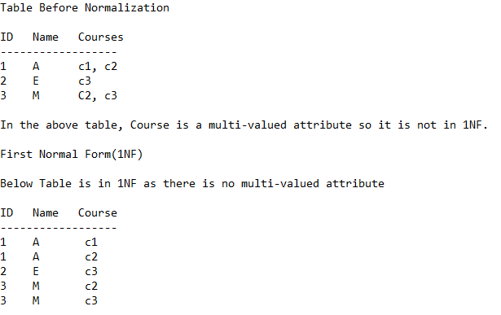
Another Example to illustrate Normalization [1NF – 2NF – 3NF]

Slide 200
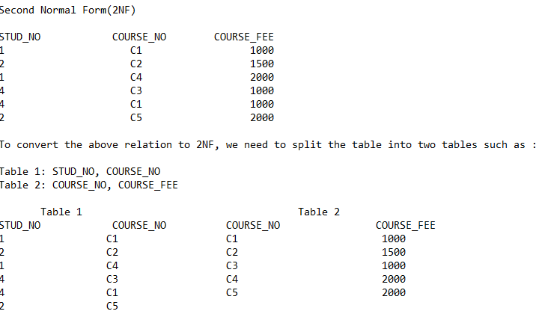
2NF

Slide 201
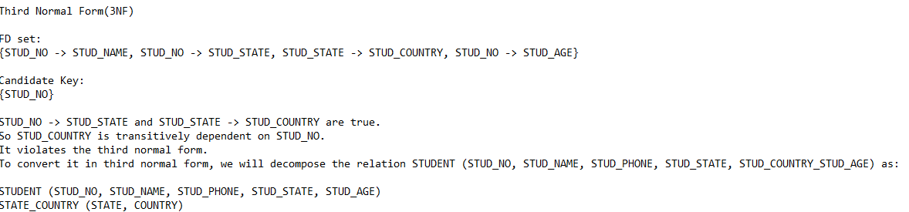
3NF

Slide 202
Similarly Drill Down
From the previous Example, drill down to BCNF and other Normal Forms

Slide 203
MODULE 2

Slide 204
Storage and File Structure
Overview of Physical Storage Media
Magnetic Disks
RAID
Tertiary Storage
Storage Access
File Organization
Organization of Records in Files
Data-Dictionary Storage

Slide 205
Classification of Physical Storage Media
Speed with which data can be accessed
Cost per unit of data
Reliability
data loss on power failure or system crash
physical failure of the storage device
Can differentiate storage into:
volatile storage: loses contents when power is switched off
non-volatile storage:
Contents persist even when power is switched off.
Includes secondary and tertiary storage, as well as batter- backed up main-memory.

Slide 206
Physical Storage Media
Cache – fastest and most costly form of storage; volatile; managed by the computer system hardware.
Main memory:
fast access (10s to 100s of nanoseconds;
1 nanosecond = 10^{–9} seconds)
generally too small (or too expensive) to store the entire database
capacities of up to a few Gigabytes widely used currently
Capacities have gone up and per-byte costs have decreased steadily and rapidly (roughly factor of 2 every 2 to 3 years)
Volatile — contents of main memory are usually lost if a power failure or system crash occurs.

Slide 207
Physical Storage Media (Cont.)
Flash memory
Data survives power failure
Data can be written at a location only once, but location can be erased and written to again
Can support only a limited number (10K – 1M) of write/erase cycles.
Erasing of memory has to be done to an entire bank of memory
Reads are roughly as fast as main memory
But writes are slow (few microseconds), erase is slower
Widely used in embedded devices such as digital cameras, phones, and USB keys

Slide 208
Physical Storage Media (Cont.)
Magnetic-disk
Data is stored on spinning disk, and read/written magnetically
Primary medium for the long-term storage of data; typically stores entire database.
Data must be moved from disk to main memory for access, and written back for storage
Much slower access than main memory (more on this later)
direct-access – possible to read data on disk in any order, unlike magnetic tape
Capacities range up to roughly 1.5 TB as of 2009
Much larger capacity and cost/byte than main memory/flash memory
Growing constantly and rapidly with technology improvements (factor of 2 to 3 every 2 years)
Survives power failures and system crashes
disk failure can destroy data, but is rare

Slide 209
Physical Storage Media (Cont.)
Optical storage
non-volatile, data is read optically from a spinning disk using a laser
CD-ROM (640 MB) and DVD (4.7 to 17 GB) most popular forms
Blu-ray disks: 27 GB to 54 GB
Write-one, read-many (WORM) optical disks used for archival storage (CD-R, DVD-R, DVD+R)
Multiple write versions also available (CD-RW, DVD-RW, DVD+RW, and DVD-RAM)
Reads and writes are slower than with magnetic disk
Juke-box systems, with large numbers of removable disks, a few drives, and a mechanism for automatic loading/unloading of disks available for storing large volumes of data

Slide 210
Physical Storage Media (Cont.)
Tape storage
non-volatile, used primarily for backup (to recover from disk failure), and for archival data
sequential-access – much slower than disk
very high capacity (40 to 300 GB tapes available)
tape can be removed from drive ⇒ storage costs much cheaper than disk, but drives are expensive
Tape jukeboxes available for storing massive amounts of data
hundreds of terabytes (1 terabyte = 10⁹ bytes) to even multiple petabytes (1 petabyte = 10¹² bytes)

Slide 211
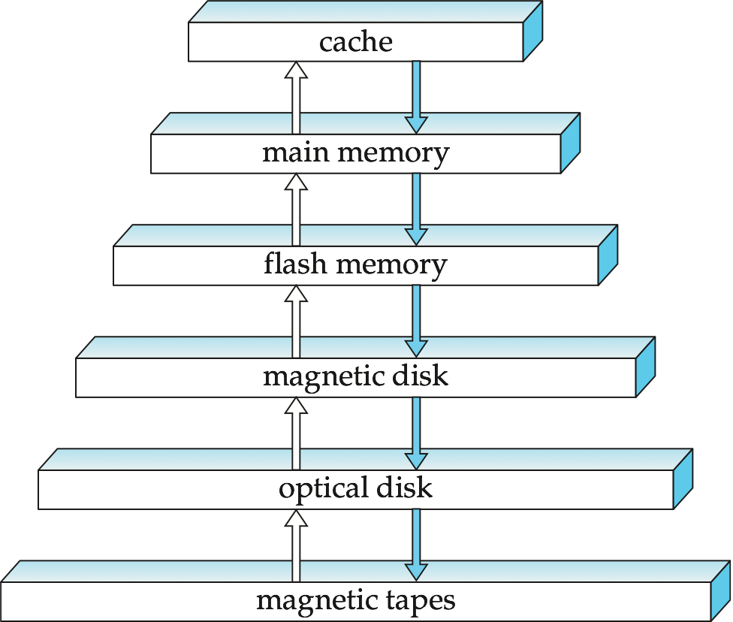
Storage Hierarchy

Slide 212
Storage Hierarchy (Cont.)
primary storage: Fastest media but volatile (cache, main memory).
secondary storage: next level in hierarchy, non-volatile, moderately fast access time
also called on-line storage
E.g. flash memory, magnetic disks
tertiary storage: lowest level in hierarchy, non-volatile, slow access time
also called off-line storage
E.g. magnetic tape, optical storage

Slide 213
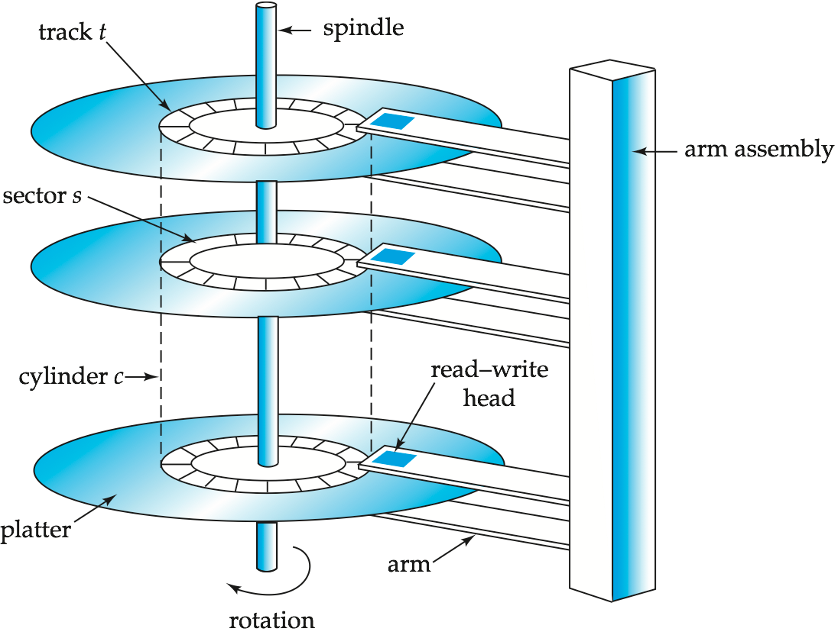
Magnetic Hard Disk Mechanism
NOTE: Diagram is schematic, and simplifies the structure of actual disk drives

Slide 214
Magnetic Disks
Read-write head
Positioned very close to the platter surface (almost touching it)
Reads or writes magnetically encoded information.
Surface of platter divided into circular tracks
Over 50K-100K tracks per platter on typical hard disks
Each track is divided into sectors.
A sector is the smallest unit of data that can be read or written.
Sector size typically 512 bytes
Typical sectors per track: 500 to 1000 (on inner tracks) to 1000 to 2000 (on outer tracks)
To read/write a sector
disk arm swings to position head on right track
platter spins continually; data is read/written as sector passes under head
Head-disk assemblies
multiple disk platters on a single spindle (1 to 5 usually)
one head per platter, mounted on a common arm.
Cylinder i consists of i^{th} track of all the platters

Slide 215
Magnetic Disks (Cont.)
Earlier generation disks were susceptible to head-crashes
Surface of earlier generation disks had metal-oxide coatings which would disintegrate on head crash and damage all data on disk
Current generation disks are less susceptible to such disastrous failures, although individual sectors may get corrupted
Disk controller – interfaces between the computer system and the disk drive hardware.
accepts high-level commands to read or write a sector
initiates actions such as moving the disk arm to the right track and actually reading or writing the data
Computes and attaches checksums to each sector to verify that data is read back correctly
If data is corrupted, with very high probability stored checksum won’t match recomputed checksum
Ensures successful writing by reading back sector after writing it
Performs remapping of bad sectors

Slide 216
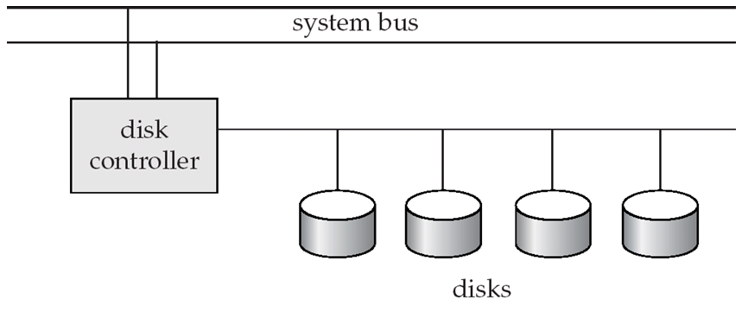
Disk Subsystem
Multiple disks connected to a computer system through a controller
Controllers functionality (checksum, bad sector remapping) often carried out by individual disks; reduces load on controller
Disk interface standards families
ATA (AT adaptor) range of standards
SATA (Serial ATA)
SCSI (Small Computer System Interconnect) range of standards
SAS (Serial Attached SCSI)
Several variants of each standard (different speeds and capabilities)

Slide 217
Disk Subsystem
Disks usually connected directly to computer system
In Storage Area Networks (SAN), a large number of disks are connected by a high-speed network to a number of servers
In Network Attached Storage (NAS) networked storage provides a file system interface using networked file system protocol, instead of providing a disk system interface

Slide 218
Performance Measures of Disks
Access time – the time it takes from when a read or write request is issued to when data transfer begins. Consists of:
Seek time – time it takes to reposition the arm over the correct track.
Average seek time is 1/2 the worst case seek time.
Would be 1/3 if all tracks had the same number of sectors, and we ignore the time to start and stop arm movement
4 to 10 milliseconds on typical disks
Rotational latency – time it takes for the sector to be accessed to appear under the head.
Average latency is 1/2 of the worst case latency.
4 to 11 milliseconds on typical disks (5400 to 15000 r.p.m.)
Data-transfer rate – the rate at which data can be retrieved from or stored to the disk.
25 to 100 MB per second max rate, lower for inner tracks
Multiple disks may share a controller, so rate that controller can handle is also important
E.g. SATA: 150 MB/sec, SATA-II 3Gb (300 MB/sec)
Ultra 320 SCSI: 320 MB/s, SAS (3 to 6 Gb/sec)
Fiber Channel (FC2Gb or 4Gb): 256 to 512 MB/s

Slide 219
Performance Measures (Cont.)
Mean time to failure (MTTF) – the average time the disk is expected to run continuously without any failure.
Typically 3 to 5 years
Probability of failure of new disks is quite low, corresponding to a “theoretical MTTF” of 500,000 to 1,200,000 hours for a new disk
E.g., an MTTF of 1,200,000 hours for a new disk means that given 1000 relatively new disks, on an average one will fail every 1200 hours
MTTF decreases as disk ages

Slide 220
Optimization of Disk-Block Access
Block – a contiguous sequence of sectors from a single track
data is transferred between disk and main memory in blocks
sizes range from 512 bytes to several kilobytes
Smaller blocks: more transfers from disk
Larger blocks: more space wasted due to partially filled blocks
Typical block sizes today range from 4 to 16 kilobytes
Disk-arm-scheduling algorithms order pending accesses to tracks so that disk arm movement is minimized
elevator algorithm:
R6
R3
R1
R5
R2
R4
Inner track
Outer track

Slide 221
Optimization of Disk Block Access (Cont.)
File organization – optimize block access time by organizing the blocks to correspond to how data will be accessed
E.g. Store related information on the same or nearby cylinders.
Files may get fragmented over time
E.g. if data is inserted to/deleted from the file
Or free blocks on disk are scattered, and newly created file has its blocks scattered over the disk
Sequential access to a fragmented file results in increased disk arm movement
Some systems have utilities to defragment the file system, in order to speed up file access

Slide 222
Optimization of Disk Block Access (Cont.)
Nonvolatile write buffers speed up disk writes by writing blocks to a non-volatile RAM buffer immediately
Non-volatile RAM: battery backed up RAM or flash memory
Even if power fails, the data is safe and will be written to disk when power returns
Controller then writes to disk whenever the disk has no other requests or request has been pending for some time
Database operations that require data to be safely stored before continuing can continue without waiting for data to be written to disk
Writes can be reordered to minimize disk arm movement
Log disk – a disk devoted to writing a sequential log of block updates
Used exactly like nonvolatile RAM
Write to log disk is very fast since no seeks are required
No need for special hardware (NV-RAM)
File systems typically reorder writes to disk to improve performance
Journaling file systems write data in safe order to NV-RAM or log disk
Reordering without journaling: risk of corruption of file system data

Slide 223
Flash Storage
NOR flash vs NAND flash
NAND flash
used widely for storage, since it is much cheaper than NOR flash
requires page-at-a-time read (page: 512 bytes to 4 KB)
transfer rate around 20 MB/sec
solid state disks: use multiple flash storage devices to provide higher transfer rate of 100 to 200 MB/sec
erase is very slow (1 to 2 millisecs)
erase block contains multiple pages
remapping of logical page addresses to physical page addresses avoids waiting for erase
translation table tracks mapping
also stored in a label field of flash page
remapping carried out by flash translation layer
after 100,000 to 1,000,000 erases, erase block becomes unreliable and cannot be used
wear leveling

Slide 224
RAID
RAID: Redundant Arrays of Independent Disks
disk organization techniques that manage a large numbers of disks, providing a view of a single disk of
high capacity and high speed by using multiple disks in parallel,
high reliability by storing data redundantly, so that data can be recovered even if a disk fails
The chance that some disk out of a set of N disks will fail is much higher than the chance that a specific single disk will fail.
E.g., a system with 100 disks, each with MTTF of 100,000 hours (approx. 11 years), will have a system MTTF of 1000 hours (approx. 41 days)
Techniques for using redundancy to avoid data loss are critical with large numbers of disks
Originally a cost-effective alternative to large, expensive disks
I in RAID originally stood for ``inexpensive’’
Today RAIDs are used for their higher reliability and bandwidth.
The “I” is interpreted as independent

Slide 225
Improvement of Reliability via Redundancy
Redundancy – store extra information that can be used to rebuild information lost in a disk failure
E.g., Mirroring (or shadowing)
Duplicate every disk. Logical disk consists of two physical disks.
Every write is carried out on both disks
Reads can take place from either disk
If one disk in a pair fails, data still available in the other
Data loss would occur only if a disk fails, and its mirror disk also fails before the system is repaired
Probability of combined event is very small
Except for dependent failure modes such as fire or building collapse or electrical power surges
Mean time to data loss depends on mean time to failure, and mean time to repair
E.g. MTTF of 100,000 hours, mean time to repair of 10 hours gives mean time to data loss of 500*10⁶ hours (or 57,000 years) for a mirrored pair of disks (ignoring dependent failure modes)

Slide 226
Improvement in Performance via Parallelism
Two main goals of parallelism in a disk system:
1. Load balance multiple small accesses to increase throughput
2. Parallelize large accesses to reduce response time.
Improve transfer rate by striping data across multiple disks.
Bit-level striping – split the bits of each byte across multiple disks
In an array of eight disks, write bit i of each byte to disk i.
Each access can read data at eight times the rate of a single disk.
But seek/access time worse than for a single disk
Bit level striping is not used much any more
Block-level striping – with n disks, block i of a file goes to disk (i mod n) + 1
Requests for different blocks can run in parallel if the blocks reside on different disks
A request for a long sequence of blocks can utilize all disks in parallel

Slide 227
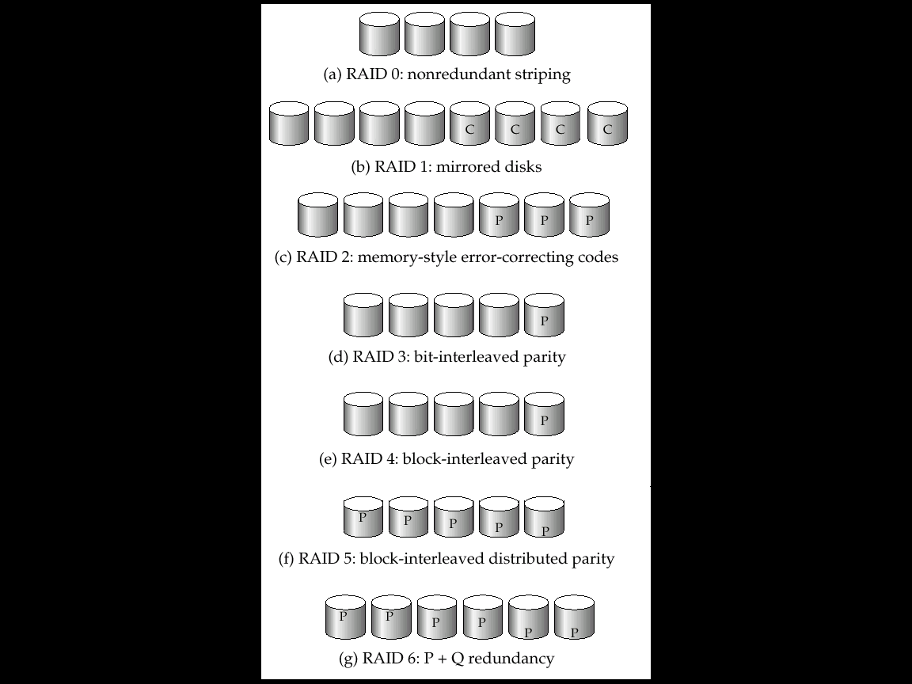
RAID Levels
Schemes to provide redundancy at lower cost by using disk striping combined with parity bits
Different RAID organizations, or RAID levels, have differing cost, performance and reliability characteristics
RAID Level 0: Block striping; non-redundant.
Used in high-performance applications where data loss is not critical.
RAID Level 1: Mirrored disks with block striping
Offers best write performance.
Popular for applications such as storing log files in a database system.

Slide 228
RAID Levels (Cont.)
RAID Level 2: Memory-Style Error-Correcting-Codes (ECC) with bit striping.
RAID Level 3: Bit-Interleaved Parity
a single parity bit is enough for error correction, not just detection, since we know which disk has failed
When writing data, corresponding parity bits must also be computed and written to a parity bit disk
To recover data in a damaged disk, compute XOR of bits from other disks (including parity bit disk)

Slide 229
RAID Levels (Cont.)
RAID Level 3 (Cont.)
Faster data transfer than with a single disk, but fewer I/Os per second since every disk has to participate in every I/O.
Subsumes Level 2 (provides all its benefits, at lower cost).
RAID Level 4: Block-Interleaved Parity; uses block-level striping, and keeps a parity block on a separate disk for corresponding blocks from N other disks.
When writing data block, corresponding block of parity bits must also be computed and written to parity disk
To find value of a damaged block, compute XOR of bits from corresponding blocks (including parity block) from other disks.

Slide 230
RAID Levels (Cont.)
RAID Level 4 (Cont.)
Provides higher I/O rates for independent block reads than Level 3
block read goes to a single disk, so blocks stored on different disks can be read in parallel
Provides high transfer rates for reads of multiple blocks than no-striping
Before writing a block, parity data must be computed
Can be done by using old parity block, old value of current block and new value of current block (2 block reads + 2 block writes)
Or by recomputing the parity value using the new values of blocks corresponding to the parity block
More efficient for writing large amounts of data sequentially
Parity block becomes a bottleneck for independent block writes since every block write also writes to parity disk

Slide 231
RAID Levels (Cont.)
RAID Level 5: Block-Interleaved Distributed Parity; partitions data and parity among all N + 1 disks, rather than storing data in N disks and parity in 1 disk.
E.g., with 5 disks, parity block for nth set of blocks is stored on disk (n mod 5) + 1, with the data blocks stored on the other 4 disks. Higher I/O rates than Level 4.
Block writes occur in parallel if the blocks and their parity blocks are on different disks.
Subsumes Level 4: provides same benefits, but avoids bottleneck of parity disk.

Slide 232
RAID Levels (Cont.)
RAID Level 6: P+Q Redundancy scheme; similar to Level 5, but stores extra redundant information to guard against multiple disk failures.
Better reliability than Level 5 at a higher cost; not used as widely.

Slide 233
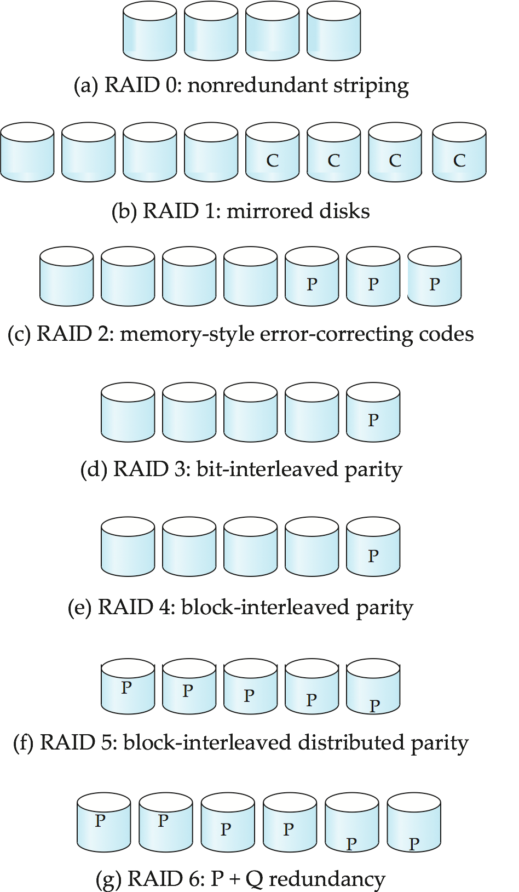
All RAID Levels in a Single Slide

Slide 234
Choice of RAID Level
Factors in choosing RAID level
Monetary cost
Performance: Number of I/O operations per second, and bandwidth during normal operation
Performance during failure
Performance during rebuild of failed disk
Including time taken to rebuild failed disk
RAID 0 is used only when data safety is not important
E.g. data can be recovered quickly from other sources
Level 2 and 4 never used since they are subsumed by 3 and 5
Level 3 is not used anymore since bit-striping forces single block reads to access all disks, wasting disk arm movement, which block striping (level 5) avoids
Level 6 is rarely used since levels 1 and 5 offer adequate safety for most applications

Slide 235
Choice of RAID Level (Cont.)
Level 1 provides much better write performance than level 5
Level 5 requires at least 2 block reads and 2 block writes to write a single block, whereas Level 1 only requires 2 block writes
Level 1 preferred for high update environments such as log disks
Level 1 had higher storage cost than level 5
disk drive capacities increasing rapidly (50%/year) whereas disk access times have decreased much less (x 3 in 10 years)
I/O requirements have increased greatly, e.g. for Web servers
When enough disks have been bought to satisfy required rate of I/O, they often have spare storage capacity
so there is often no extra monetary cost for Level 1!
Level 5 is preferred for applications with low update rate, and large amounts of data
Level 1 is preferred for all other applications

Slide 236
Software RAID and Hardware RAID
Software RAID: RAID implementations done entirely in software, with no special hardware support
Hardware RAID: RAID implementations with special hardware
Use non-volatile RAM to record writes that are being executed
Beware: power failure during write can result in corrupted disk
E.g. failure after writing one block but before writing the second in a mirrored system
Such corrupted data must be detected when power is restored
Recovery from corruption is similar to recovery from failed disk
NV-RAM helps to efficiently detected potentially corrupted blocks
Otherwise all blocks of disk must be read and compared with mirror/parity block

Slide 237
Hardware Issues (Cont.)
Latent failures: data successfully written earlier gets damaged
can result in data loss even if only one disk fails
Data scrubbing:
continually scan for latent failures, and recover from copy/parity
Hot swapping: replacement of disk while system is running, without power down
Supported by some hardware RAID systems,
reduces time to recovery, and improves availability greatly
Many systems maintain spare disks which are kept online, and used as replacements for failed disks immediately on detection of failure
Reduces time to recovery greatly
Many hardware RAID systems ensure that a single point of failure will not stop the functioning of the system by using
Redundant power supplies with battery backup
Multiple controllers and multiple interconnections to guard against controller/interconnection failures

Slide 238
Optical Disks
Compact disk-read only memory (CD-ROM)
Removable disks, 640 MB per disk
Seek time about 100 msec (optical read head is heavier and slower)
Higher latency (3000 RPM) and lower data-transfer rates (3-6 MB/s) compared to magnetic disks
Digital Video Disk (DVD)
DVD-5 holds 4.7 GB , and DVD-9 holds 8.5 GB
DVD-10 and DVD-18 are double sided formats with capacities of 9.4 GB and 17 GB
Blu-ray DVD: 27 GB (54 GB for double sided disk)
Slow seek time, for same reasons as CD-ROM
Record once versions (CD-R and DVD-R) are popular
data can only be written once, and cannot be erased.
high capacity and long lifetime; used for archival storage
Multi-write versions (CD-RW, DVD-RW, DVD+RW and DVD-RAM) also available

Slide 239
Magnetic Tapes
Hold large volumes of data and provide high transfer rates
Few GB for DAT (Digital Audio Tape) format, 10-40 GB with DLT (Digital Linear Tape) format, 100 GB+ with Ultrium format, and 330 GB with Ampex helical scan format
Transfer rates from few to 10s of MB/s
Tapes are cheap, but cost of drives is very high
Very slow access time in comparison to magnetic and optical disks
limited to sequential access.
Some formats (Accelis) provide faster seek (10s of seconds) at cost of lower capacity
Used mainly for backup, for storage of infrequently used information, and as an off-line medium for transferring information from one system to another.
Tape jukeboxes used for very large capacity storage
Multiple petabyes (10¹⁵ bytes)

Slide 240
File Organization, Record Organization and Storage Access

Slide 241
File Organization
The database is stored as a collection of files. Each file is a sequence of records. A record is a sequence of fields.
One approach:
assume record size is fixed
each file has records of one particular type only
different files are used for different relations
This case is easiest to implement; will consider variable length records later.

Slide 242
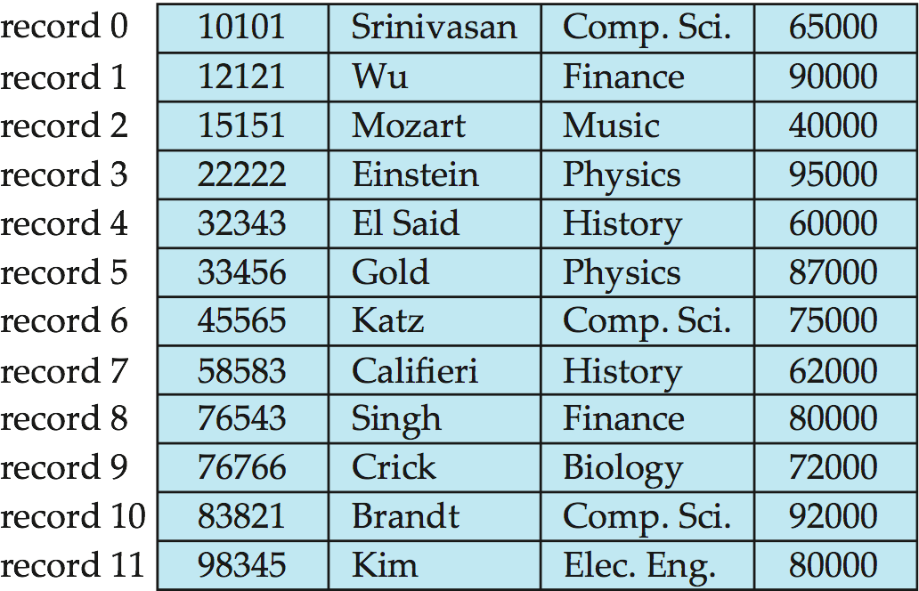
Fixed-Length Records
Simple approach:
Store record i starting from byte n ∗ (i – 1), where n is the size of each record.
Record access is simple but records may cross blocks
Modification: do not allow records to cross block boundaries
Deletion of record i: alternatives:
move records i + 1, . . ., n to i, . . . , n – 1
move record n to i
do not move records, but link all free records on a free list

Slide 243
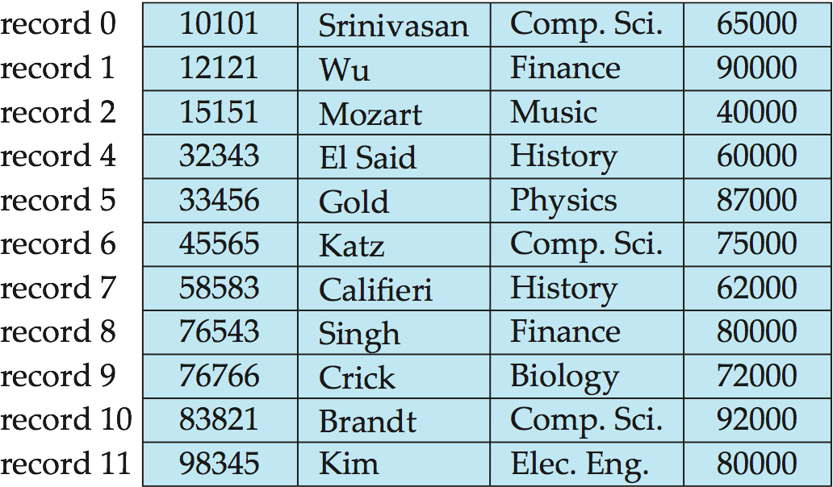
Deleting record 3 and compacting

Slide 244
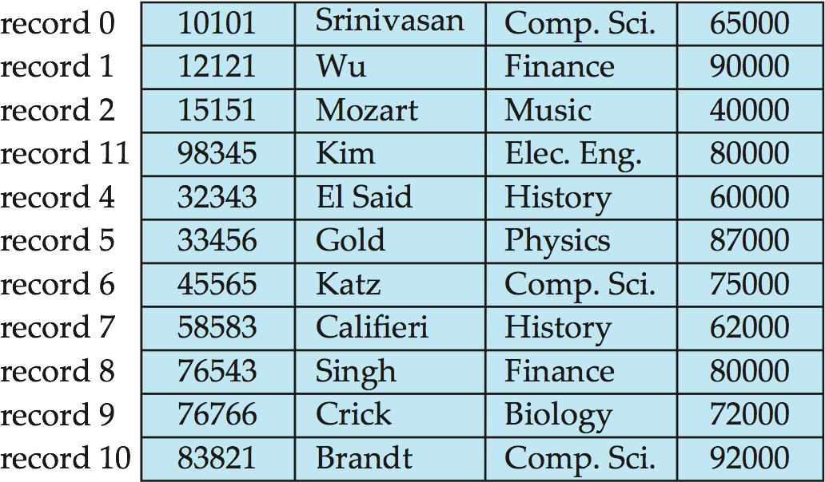
Deleting record 3 and moving last record

Slide 245
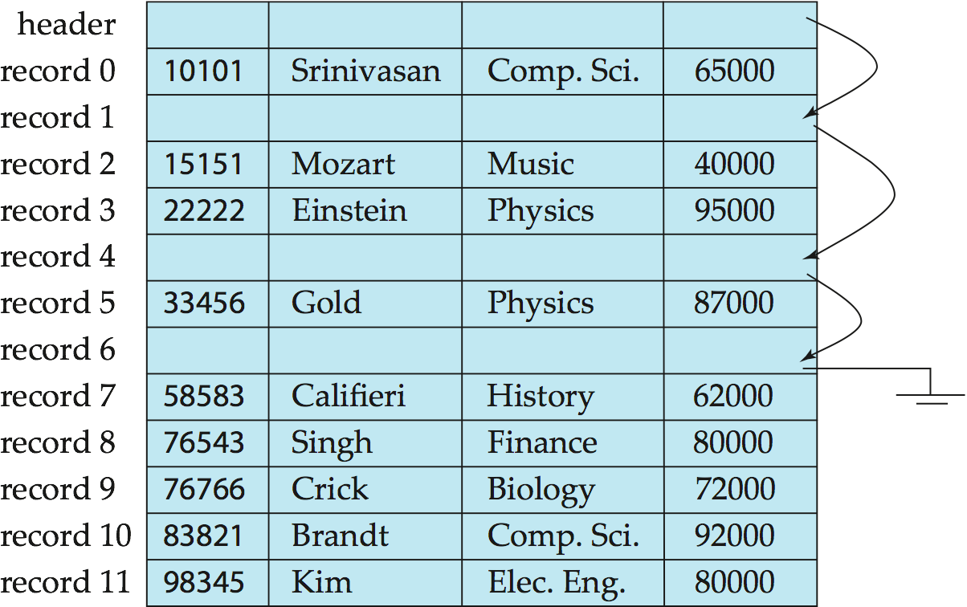
Free Lists
Store the address of the first deleted record in the file header.
Use this first record to store the address of the second deleted record, and so on
Can think of these stored addresses as pointers since they “point” to the location of a record.
More space efficient representation: reuse space for normal attributes of free records to store pointers. (No pointers stored in in-use records.)

Slide 246
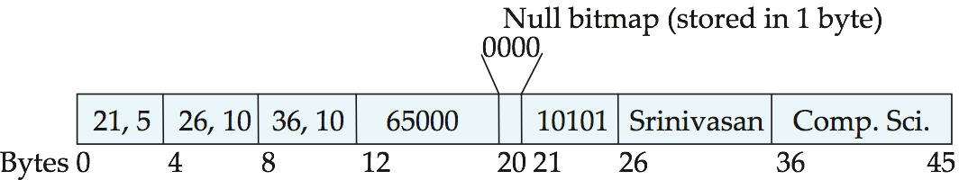
Variable-Length Records
Variable-length records arise in database systems in several ways:
Storage of multiple record types in a file.
Record types that allow variable lengths for one or more fields such as strings (varchar)
Record types that allow repeating fields (used in some older data models).
Attributes are stored in order
Variable length attributes represented by fixed size (offset, length), with actual data stored after all fixed length attributes
Null values represented by null-value bitmap

Slide 247
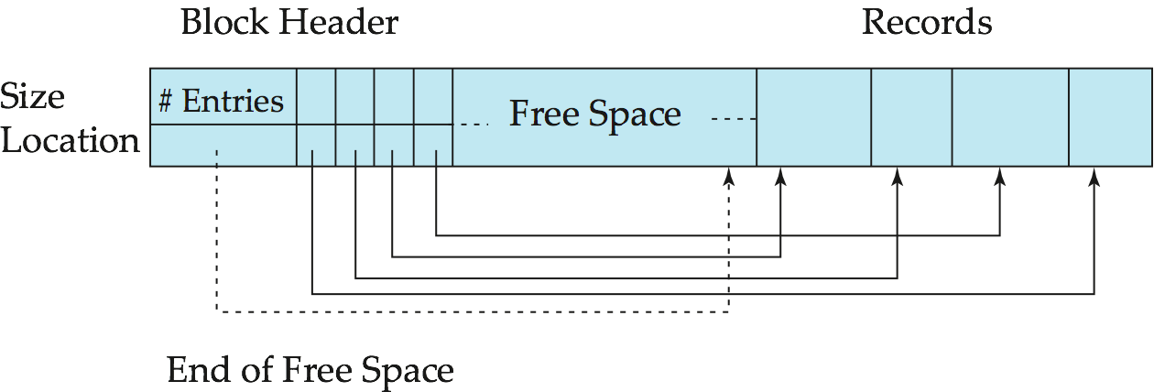
Variable-Length Records: Slotted Page Structure
Slotted page header contains:
number of record entries
end of free space in the block
location and size of each record
Records can be moved around within a page to keep them contiguous with no empty space between them; entry in the header must be updated.
Pointers should not point directly to record — instead they should point to the entry for the record in header.

Slide 248
Organization of Records in Files
Heap – a record can be placed anywhere in the file where there is space
Sequential – store records in sequential order, based on the value of the search key of each record
Hashing – a hash function computed on some attribute of each record; the result specifies in which block of the file the record should be placed
Records of each relation may be stored in a separate file. In a multitable clustering file organization records of several different relations can be stored in the same file
Motivation: store related records on the same block to minimize I/O

Slide 249
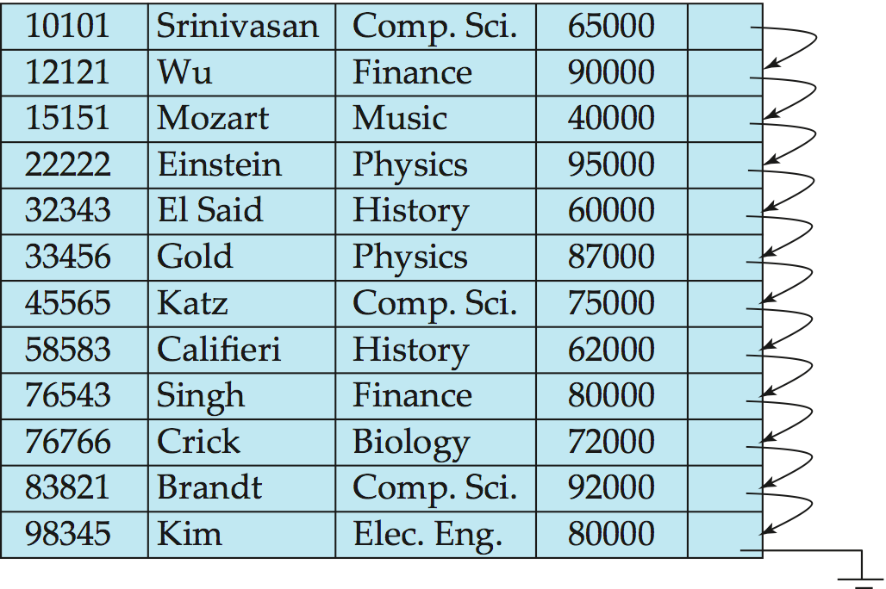
Sequential File Organization
Suitable for applications that require sequential processing of the entire file
The records in the file are ordered by a search-key

Slide 250
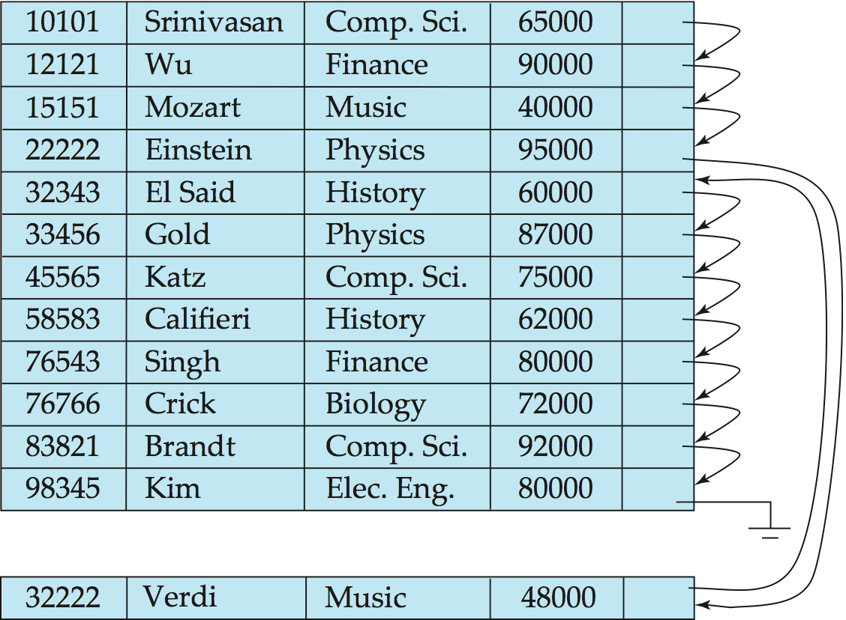
Sequential File Organization (Cont.)
Deletion – use pointer chains
Insertion –locate the position where the record is to be inserted
if there is free space insert there
if no free space, insert the record in an overflow block
In either case, pointer chain must be updated
Need to reorganize the file from time to time to restore sequential order

Slide 251
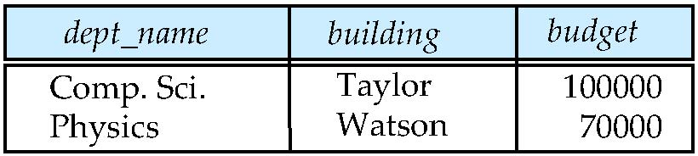
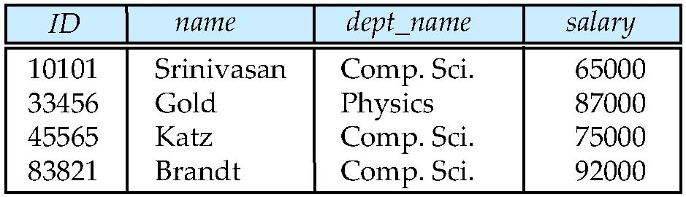
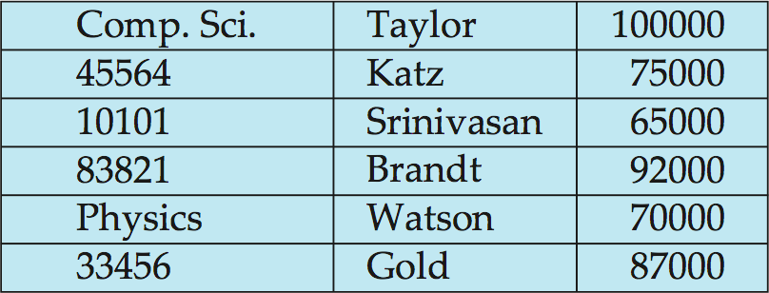
Multitable Clustering File Organization
Store several relations in one file using a multitable clustering file organization
department
instructor
multitable clustering
of department and
instructor

Slide 252
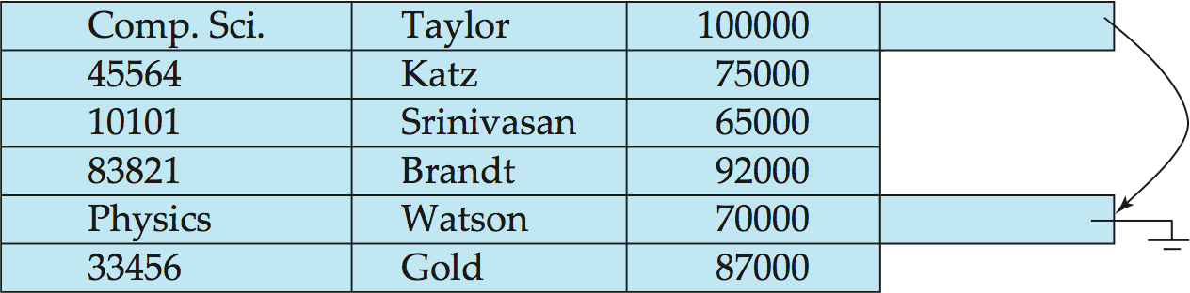
Multitable Clustering File Organization (cont.)
good for queries involving department instructor, and for queries involving one single department and its instructors
bad for queries involving only department
results in variable size records
Can add pointer chains to link records of a particular relation

Slide 253
Data Dictionary Storage
The Data dictionary (also called system catalog) stores metadata; that is, data about data, such as
Information about relations
names of relations
names, types and lengths of attributes of each relation
names and definitions of views
integrity constraints
User and accounting information, including passwords
Statistical and descriptive data
number of tuples in each relation
Physical file organization information
How relation is stored (sequential/hash/…)
Physical location of relation
Information about indices (Chapter 11)

Slide 254
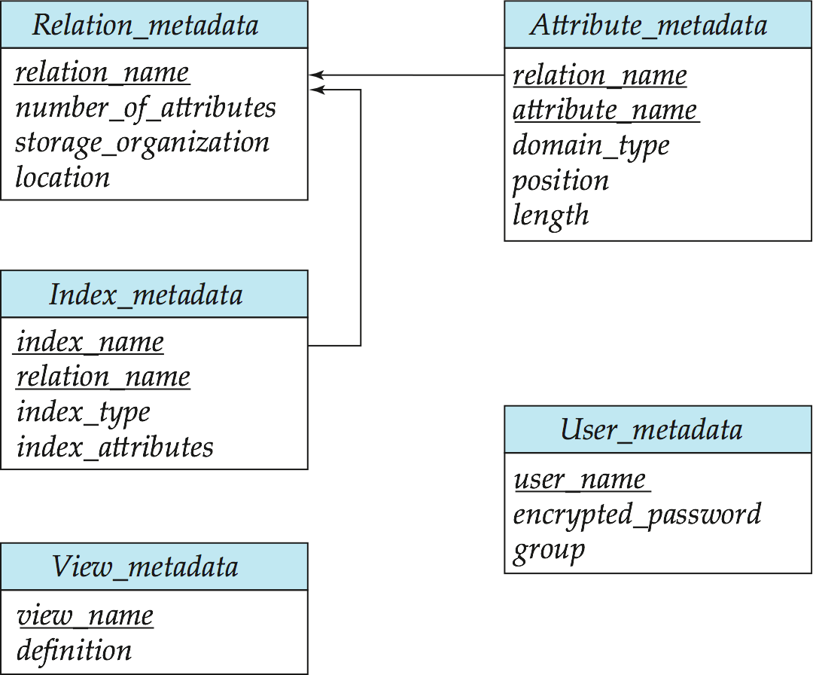
Relational Representation of System Metadata
Relational representation on disk
Specialized data structures designed for efficient access, in memory

Slide 255
Storage Access
A database file is partitioned into fixed-length storage units called blocks. Blocks are units of both storage allocation and data transfer.
Database system seeks to minimize the number of block transfers between the disk and memory. We can reduce the number of disk accesses by keeping as many blocks as possible in main memory.
Buffer – portion of main memory available to store copies of disk blocks.
Buffer manager – subsystem responsible for allocating buffer space in main memory.
Notes:
255

Slide 256
Buffer Manager
Programs call on the buffer manager when they need a block from disk.
If the block is already in the buffer, buffer manager returns the address of the block in main memory
If the block is not in the buffer, the buffer manager
Allocates space in the buffer for the block
Replacing (throwing out) some other block, if required, to make space for the new block.
Replaced block written back to disk only if it was modified since the most recent time that it was written to/fetched from the disk.
Reads the block from the disk to the buffer, and returns the address of the block in main memory to requester.
Notes:
256

Slide 257
Buffer-Replacement Policies
Most operating systems replace the block least recently used (LRU strategy)
Idea behind LRU – use past pattern of block references as a predictor of future references
Queries have well-defined access patterns (such as sequential scans), and a database system can use the information in a user’s query to predict future references
LRU can be a bad strategy for certain access patterns involving repeated scans of data
For example: when computing the join of 2 relations r and s by a nested loops for each tuple tr of r do for each tuple ts of s do if the tuples tr and ts match …
Mixed strategy with hints on replacement strategy provided by the query optimizer is preferable
Notes:
257

Slide 258
Buffer-Replacement Policies (Cont.)
Pinned block – memory block that is not allowed to be written back to disk.
Toss-immediate strategy – frees the space occupied by a block as soon as the final tuple of that block has been processed
Most recently used (MRU) strategy – system must pin the block currently being processed. After the final tuple of that block has been processed, the block is unpinned, and it becomes the most recently used block.
Buffer manager can use statistical information regarding the probability that a request will reference a particular relation
E.g., the data dictionary is frequently accessed. Heuristic: keep data-dictionary blocks in main memory buffer
Buffer managers also support forced output of blocks for the purpose of recovery (more in Chapter 16)
Notes:
258

Slide 259
Query Processing
Overview
Measures of Query Cost
Selection Operation
Sorting
Join Operation
Other Operations
Evaluation of Expressions

Slide 260
Basic Steps in Query Processing
1. Parsing and translation
2. Optimization
3. Evaluation

Slide 261
Basic Steps in Query Processing (Cont.)
Parsing and translation
translate the query into its internal form. This is then translated into relational algebra.
Parser checks syntax, verifies relations
Evaluation
The query-execution engine takes a query-evaluation plan, executes that plan, and returns the answers to the query.

Slide 262
Basic Steps in Query Processing : Optimization
A relational algebra expression may have many equivalent expressions
E.g., σ_{salary<75000}(∏_{salary}(instructor)) is equivalent to ∏_{salary}(σ_{salary<75000}(instructor))
Each relational algebra operation can be evaluated using one of several different algorithms
Correspondingly, a relational-algebra expression can be evaluated in many ways.
Annotated expression specifying detailed evaluation strategy is called an evaluation-plan.
E.g., can use an index on salary to find instructors with salary < 75000,
or can perform complete relation scan and discard instructors with salary ≥ 75000

Slide 263
Basic Steps: Optimization (Cont.)
Query Optimization: Amongst all equivalent evaluation plans choose the one with lowest cost.
Cost is estimated using statistical information from the database catalog
e.g. number of tuples in each relation, size of tuples, etc.
In this chapter we study
How to measure query costs
Algorithms for evaluating relational algebra operations
How to combine algorithms for individual operations in order to evaluate a complete expression
In Chapter 14
We study how to optimize queries, that is, how to find an evaluation plan with lowest estimated cost

Slide 264
Measures of Query Cost
Cost is generally measured as total elapsed time for answering query
Many factors contribute to time cost
disk accesses, CPU, or even network communication
Typically disk access is the predominant cost, and is also relatively easy to estimate. Measured by taking into account
Number of seeks * average-seek-cost
Number of blocks read * average-block-read-cost
Number of blocks written * average-block-write-cost
Cost to write a block is greater than cost to read a block
data is read back after being written to ensure that the write was successful

Slide 265
Measures of Query Cost (Cont.)
For simplicity we just use the number of block transfers from disk and the number of seeks as the cost measures
t_{T} – time to transfer one block
t_{S} – time for one seek
Cost for b block transfers plus S seeks b * t_{T} + S * t_{S}
We ignore CPU costs for simplicity
Real systems do take CPU cost into account
We do not include cost to writing output to disk in our cost formulae

Slide 266
Measures of Query Cost (Cont.)
Several algorithms can reduce disk IO by using extra buffer space
Amount of real memory available to buffer depends on other concurrent queries and OS processes, known only during execution
We often use worst case estimates, assuming only the minimum amount of memory needed for the operation is available
Required data may be buffer resident already, avoiding disk I/O
But hard to take into account for cost estimation
Notes:
266

Slide 267
Selection Operation
File scan
Algorithm A1 (linear search). Scan each file block and test all records to see whether they satisfy the selection condition.
Cost estimate = b_{r} block transfers + 1 seek
b_{r} denotes number of blocks containing records from relation r
If selection is on a key attribute, can stop on finding record
cost = (b_{r} /2) block transfers + 1 seek
Linear search can be applied regardless of
selection condition or
ordering of records in the file, or
availability of indices
Note: binary search generally does not make sense since data is not stored consecutively
except when there is an index available,
and binary search requires more seeks than index search

Slide 268
Selections Using Indices
Index scan – search algorithms that use an index
selection condition must be on search-key of index.
A2 (primary index, equality on key). Retrieve a single record that satisfies the corresponding equality condition
Cost = (h_{i} + 1) * (t_{T} + t_{S})
A3 (primary index, equality on nonkey) Retrieve multiple records.
Records will be on consecutive blocks
Let b = number of blocks containing matching records
Cost = h_{i} * (t_{T} + t_{S}) + t_{S} + t_{T} * b

Slide 269
Selections Using Indices
A4 (secondary index, equality on nonkey).
Retrieve a single record if the search-key is a candidate key
Cost = (h_{i} + 1) * (t_{T} + t_{S})
Retrieve multiple records if search-key is not a candidate key
each of n matching records may be on a different block
Cost = (h_{i} + n) * (t_{T} + t_{S})
Can be very expensive!
Notes:
269

Slide 270
Selections Involving Comparisons
Can implement selections of the form σ_{A≤V} (r) or σ_{A ≥ V}(r) by using
a linear file scan,
or by using indices in the following ways:
A5 (primary index, comparison). (Relation is sorted on A)
For σ_{A ≥ V}(r) use index to find first tuple ≥ v and scan relation sequentially from there
For σ_{A≤V} (r) just scan relation sequentially till first tuple > v; do not use index
A6 (secondary index, comparison).
For σ_{A ≥ V}(r) use index to find first index entry ≥ v and scan index sequentially from there, to find pointers to records.
For σ_{A≤V} (r) just scan leaf pages of index finding pointers to records, till first entry > v
In either case, retrieve records that are pointed to
requires an I/O for each record
Linear file scan may be cheaper

Slide 271
Implementation of Complex Selections
Conjunction: σ_{θ1}∧ _{θ2}∧. . . _{θn}(r)
A7 (conjunctive selection using one index).
Select a combination of θ_{i} and algorithms A1 through A7 that results in the least cost for σ_{θi} (r).
Test other conditions on tuple after fetching it into memory buffer.
A8 (conjunctive selection using composite index).
Use appropriate composite (multiple-key) index if available.
A9 (conjunctive selection by intersection of identifiers).
Requires indices with record pointers.
Use corresponding index for each condition, and take intersection of all the obtained sets of record pointers.
Then fetch records from file
If some conditions do not have appropriate indices, apply test in memory.

Slide 272
Algorithms for Complex Selections
Disjunction:σ_{θ1}∨ _{θ2} ∨. . . _{θn} (r).
A10 (disjunctive selection by union of identifiers).
Applicable if all conditions have available indices.
Otherwise use linear scan.
Use corresponding index for each condition, and take union of all the obtained sets of record pointers.
Then fetch records from file
Negation: σ_{¬θ}(r)
Use linear scan on file
If very few records satisfy ¬θ, and an index is applicable to θ
Find satisfying records using index and fetch from file

Slide 273
Sorting
We may build an index on the relation, and then use the index to read the relation in sorted order. May lead to one disk block access for each tuple.
For relations that fit in memory, techniques like quicksort can be used. For relations that don’t fit in memory, external sort-merge is a good choice.

Slide 274
External Sort-Merge
Let M denote memory size (in pages).
Create sorted runs. Let i be 0 initially. Repeatedly do the following till the end of the relation: (a) Read M blocks of relation into memory (b) Sort the in-memory blocks (c) Write sorted data to run R_{i}; increment i. Let the final value of i be N
Merge the runs (next slide)…..

Slide 275
External Sort-Merge (Cont.)
Merge the runs (N-way merge). We assume (for now) that N < M.
Use N blocks of memory to buffer input runs, and 1 block to buffer output. Read the first block of each run into its buffer page
repeat
Select the first record (in sort order) among all buffer pages
Write the record to the output buffer. If the output buffer is full write it to disk.
Delete the record from its input buffer page. If the buffer page becomes empty then read the next block (if any) of the run into the buffer.
until all input buffer pages are empty:

Slide 276
External Sort-Merge (Cont.)
If N ≥ M, several merge passes are required.
In each pass, contiguous groups of M - 1 runs are merged.
A pass reduces the number of runs by a factor of M -1, and creates runs longer by the same factor.
E.g. If M=11, and there are 90 runs, one pass reduces the number of runs to 9, each 10 times the size of the initial runs
Repeated passes are performed till all runs have been merged into one.

Slide 277
Example: External Sorting Using Sort-Merge

Slide 278
External Merge Sort (Cont.)
Cost analysis:
1 block per run leads to too many seeks during merge
Instead use b_{b} buffer blocks per run
➔ read/write b_{b} blocks at a time
Can merge ⎣M/b_{b}⎦–1 runs in one pass
Total number of merge passes required: ⎡log _{⎣M/bb⎦–1}(b_{r}/M)⎤.
Block transfers for initial run creation as well as in each pass is 2b_{r}
for final pass, we don’t count write cost
we ignore final write cost for all operations since the output of an operation may be sent to the parent operation without being written to disk
Thus total number of block transfers for external sorting: b_{r} ( 2 ⎡log _{⎣M/bb⎦–1} (b_{r} / M)⎤ + 1) ⎡
Seeks: next slide

Slide 279
External Merge Sort (Cont.)
Cost of seeks
During run generation: one seek to read each run and one seek to write each run
2 ⎡b_{r} / M⎤
During the merge phase
Need 2 ⎡b_{r} / b_{b}⎤ seeks for each merge pass
except the final one which does not require a write
Total number of seeks: 2 ⎡b_{r} / M⎤ + ⎡b_{r} / b_{b}⎤ (2 ⎡log_{⎣M/bb⎦–1}(b_{r} / M)⎤ -1)

Slide 280

Joins and its Types

Slide 281
(INNER) JOIN : Returns records that have matching values in both tables. LEFT (OUTER) JOIN : Returns all records from the left table, and the matched records from the right table. RIGHT (OUTER) JOIN : Returns all records from the right table, and the matched records from the left table.

Slide 282
he CARTESIAN JOIN or CROSS JOIN returns the Cartesian product of the sets of records from two or more joined tables
A Cartesian product is the result of joining every row in one table with every row in another table. This occurs when there is no WHERE clause to restrict rows. While this is legitimate in some cases, most occurrences of a Cartesian product are mistakes.

Slide 283
Nested-Loop Join
To compute the theta join r _{θ} s for each tuple t_{r} in r do begin for each tuple t_{s} in s do begin test pair (t_{r},t_{s}) to see if they satisfy the join condition θ if they do, add t_{r} • t_{s} to the result. end end
r is called the outer relation and s the inner relation of the join.
Requires no indices and can be used with any kind of join condition.
Expensive since it examines every pair of tuples in the two relations.

Slide 284
Nested-Loop Join (Cont.)
In the worst case, if there is enough memory only to hold one block of each relation, the estimated cost is n_{r} ∗ b_{s} + b_{r} block transfers, plus n_{r} + b_{r} seeks
If the smaller relation fits entirely in memory, use that as the inner relation.
Reduces cost to b_{r} + b_{s} block transfers and 2 seeks
Assuming worst case memory availability cost estimate is
with student as outer relation:
5000 ∗ 400 + 100 = 2,000,100 block transfers,
5000 + 100 = 5100 seeks
with takes as the outer relation
10000 ∗ 100 + 400 = 1,000,400 block transfers and 10,400 seeks
If smaller relation (student) fits entirely in memory, the cost estimate will be 500 block transfers.
Block nested-loops algorithm (next slide) is preferable.

Slide 285
Block Nested-Loop Join
Variant of nested-loop join in which every block of inner relation is paired with every block of outer relation.
for each block B_{r} of r do begin for each block B_{s} of s do begin for each tuple t_{r} in B_{r} do begin for each tuple t_{s} in B_{s} do begin Check if (t_{r},t_{s}) satisfy the join condition if they do, add t_{r} • t_{s} to the result. end end end end

Slide 286
Block Nested-Loop Join (Cont.)
Worst case estimate: b_{r} ∗ b_{s} + b_{r} block transfers + 2 * b_{r} seeks
Each block in the inner relation s is read once for each block in the outer relation
Best case: b_{r} + b_{s} block transfers + 2 seeks.
Improvements to nested loop and block nested loop algorithms:
In block nested-loop, use M — 2 disk blocks as blocking unit for outer relations, where M = memory size in blocks; use remaining two blocks to buffer inner relation and output
Cost = ⎡b_{r} / (M-2)⎤ ∗ b_{s} + b_{r} block transfers + 2 ⎡b_{r} / (M-2)⎤ seeks
If equi-join attribute forms a key or inner relation, stop inner loop on first match
Scan inner loop forward and backward alternately, to make use of the blocks remaining in buffer (with LRU replacement)
Use index on inner relation if available (next slide)

Slide 287
Indexed Nested-Loop Join
Index lookups can replace file scans if
join is an equi-join or natural join and
an index is available on the inner relation’s join attribute
Can construct an index just to compute a join.
For each tuple t_{r} in the outer relation r, use the index to look up tuples in s that satisfy the join condition with tuple t_{r}.
Worst case: buffer has space for only one page of r, and, for each tuple in r, we perform an index lookup on s.
Cost of the join: b_{r} (t_{T} + t_{S}) + n_{r} ∗ c
Where c is the cost of traversing index and fetching all matching s tuples for one tuple or r
c can be estimated as cost of a single selection on s using the join condition.
If indices are available on join attributes of both r and s, use the relation with fewer tuples as the outer relation.

Slide 288
Example of Nested-Loop Join Costs
Compute student takes, with student as the outer relation.
Let takes have a primary B⁺-tree index on the attribute ID, which contains 20 entries in each index node.
Since takes has 10,000 tuples, the height of the tree is 4, and one more access is needed to find the actual data
student has 5000 tuples
Cost of block nested loops join
400*100 + 100 = 40,100 block transfers + 2 * 100 = 200 seeks
assuming worst case memory
may be significantly less with more memory
Cost of indexed nested loops join
100 + 5000 * 5 = 25,100 block transfers and seeks.
CPU cost likely to be less than that for block nested loops join

Slide 289
Complex Joins
Join with a conjunctive condition:
r _{θ1∧ θ 2∧... ∧ θ n} s
Either use nested loops/block nested loops, or
Compute the result of one of the simpler joins r _{θi} s
final result comprises those tuples in the intermediate result that satisfy the remaining conditions
θ₁ ∧ . . . ∧ θ_{i –1} ∧ θ_{i +1} ∧ . . . ∧ θ_{n}
Join with a disjunctive condition
r _{θ1 ∨ θ2 ∨... ∨ θn} s
Either use nested loops/block nested loops, or
Compute as the union of the records in individual joins r _{θ i} s:
(r _{θ1} s) ∪ (r _{θ2} s) ∪ . . . ∪ (r _{θn} s)

Slide 290
Other Operations
Duplicate elimination can be implemented via hashing or sorting.
On sorting duplicates will come adjacent to each other, and all but one set of duplicates can be deleted.
Optimization: duplicates can be deleted during run generation as well as at intermediate merge steps in external sort-merge.
Hashing is similar – duplicates will come into the same bucket.
Projection:
perform projection on each tuple
followed by duplicate elimination.

Slide 291
Other Operations : Aggregation
Aggregation can be implemented in a manner similar to duplicate elimination.
Sorting or hashing can be used to bring tuples in the same group together, and then the aggregate functions can be applied on each group.
Optimization: combine tuples in the same group during run generation and intermediate merges, by computing partial aggregate values
For count, min, max, sum: keep aggregate values on tuples found so far in the group.
When combining partial aggregate for count, add up the aggregates
For avg, keep sum and count, and divide sum by count at the end

Slide 292
Other Operations : Set Operations
Set operations (∪, ∩ and ⎯): can either use variant of merge-join after sorting, or variant of hash-join.
E.g., Set operations using hashing:
Partition both relations using the same hash function
Process each partition i as follows.
Using a different hashing function, build an in-memory hash index on r_{i}.
Process s_{i} as follows
r ∪ s:
Add tuples in s_{i} to the hash index if they are not already in it.
At end of s_{i} add the tuples in the hash index to the result.

Slide 293
Other Operations : Set Operations
E.g., Set operations using hashing:
as before partition r and s,
as before, process each partition i as follows
build a hash index on r_{i}
Process s_{i} as follows
r ∩ s:
output tuples in s_{i} to the result if they are already there in the hash index
r – s:
for each tuple in s_{i}, if it is there in the hash index, delete it from the index.
At end of s_{i} add remaining tuples in the hash index to the result.
Notes:
293

Slide 294
Other Operations : Outer Join
Outer join can be computed either as
A join followed by addition of null-padded non-participating tuples.
by modifying the join algorithms.
Modifying merge join to compute r s
In r s, non participating tuples are those in r – Π_{R}(r s)
Modify merge-join to compute r s:
During merging, for every tuple t_{r} from r that do not match any tuple in s, output t_{r} padded with nulls.
Right outer-join and full outer-join can be computed similarly.

Slide 295
Other Operations : Outer Join
Modifying hash join to compute r s
If r is probe relation, output non-matching r tuples padded with nulls
If r is build relation, when probing keep track of which r tuples matched s tuples. At end of s_{i} output non-matched r tuples padded with nulls
Notes:
295

Slide 296
Evaluation of Expressions
So far: we have seen algorithms for individual operations
Alternatives for evaluating an entire expression tree
Materialization: generate results of an expression whose inputs are relations or are already computed, materialize (store) it on disk. Repeat.
Pipelining: pass on tuples to parent operations even as an operation is being executed
We study above alternatives in more detail

Slide 297
Materialization
Materialized evaluation: evaluate one operation at a time, starting at the lowest-level. Use intermediate results materialized into temporary relations to evaluate next-level operations.
E.g., in figure below, compute and store then compute the store its join with instructor, and finally compute the projection on name.

Slide 298
Materialization (Cont.)
Materialized evaluation is always applicable
Cost of writing results to disk and reading them back can be quite high
Our cost formulas for operations ignore cost of writing results to disk, so
Overall cost = Sum of costs of individual operations + cost of writing intermediate results to disk
Double buffering: use two output buffers for each operation, when one is full write it to disk while the other is getting filled
Allows overlap of disk writes with computation and reduces execution time

Slide 299
Pipelining
Pipelined evaluation : evaluate several operations simultaneously, passing the results of one operation on to the next.
E.g., in previous expression tree, don’t store result of
instead, pass tuples directly to the join.. Similarly, don’t store result of join, pass tuples directly to projection.
Much cheaper than materialization: no need to store a temporary relation to disk.
Pipelining may not always be possible – e.g., sort, hash-join.
For pipelining to be effective, use evaluation algorithms that generate output tuples even as tuples are received for inputs to the operation.
Pipelines can be executed in two ways: demand driven and producer driven

Slide 300
Pipelining (Cont.)
In demand driven or lazy evaluation
system repeatedly requests next tuple from top level operation
Each operation requests next tuple from children operations as required, in order to output its next tuple
In between calls, operation has to maintain “state” so it knows what to return next
In producer-driven or eager pipelining
Operators produce tuples eagerly and pass them up to their parents
Buffer maintained between operators, child puts tuples in buffer, parent removes tuples from buffer
if buffer is full, child waits till there is space in the buffer, and then generates more tuples
System schedules operations that have space in output buffer and can process more input tuples
Alternative name: pull and push models of pipelining

Slide 301
Pipelining (Cont.)
Implementation of demand-driven pipelining
Each operation is implemented as an iterator implementing the following operations
open()
E.g. file scan: initialize file scan
state: pointer to beginning of file
E.g.merge join: sort relations;
state: pointers to beginning of sorted relations
next()
E.g. for file scan: Output next tuple, and advance and store file pointer
E.g. for merge join: continue with merge from earlier state till next output tuple is found. Save pointers as iterator state.
close()

Slide 302
Evaluation Algorithms for Pipelining
Some algorithms are not able to output results even as they get input tuples
E.g. merge join, or hash join
intermediate results written to disk and then read back
Algorithm variants to generate (at least some) results on the fly, as input tuples are read in
E.g. hybrid hash join generates output tuples even as probe relation tuples in the in-memory partition (partition 0) are read in
Double-pipelined join technique: Hybrid hash join, modified to buffer partition 0 tuples of both relations in-memory, reading them as they become available, and output results of any matches between partition 0 tuples
When a new r₀ tuple is found, match it with existing s₀ tuples, output matches, and save it in r₀
Symmetrically for s₀ tuples

Slide 303
Transaction Management

Slide 304
Database Transaction
A Database Transaction represent real-world events of any enterprise. is a logical unit of processing in a DBMS which entails one or more database access operation.
All types of database access operation which are held between the beginning and end transaction statements are considered as a single logical transaction in DBMS.
During the transaction the database is inconsistent.
Only once the database is committed the state is changed from one consistent state to another.

Slide 305
Facts about Database Transaction
If the database operations do not update the database but only retrieve data, this type of transaction is called a read-only transaction.
A successful transaction can change the database from one CONSISTENT STATE to another
DBMS transactions must be atomic, consistent, isolated and durable

Slide 306

Transition Diagram for Database Transaction

Slide 307
ACID
ACID Properties are used for maintaining the integrity of database during transaction processing. ACID in DBMS stands for Atomicity, Consistency, Isolation, and Durability.
Atomicity: A transaction is a single unit of operation. You either execute it entirely or do not execute it at all. There cannot be partial execution.
Consistency: Once the transaction is executed, it should move from one consistent state to another.
Isolation: Transaction should be executed in isolation from other transactions.
During concurrent transaction execution, intermediate transaction results from simultaneously executed transactions should not be made available to each other. (Level 0,1,2,3)
Durability: · After successful completion of a transaction, the changes in the database should persist. Even in the case of system failures.

Slide 308
Operations in Transactions and Example
Read/Access data (R).
Write/Change data (W).
Commit.

Slide 309
Concurrency Execution
In a multi-user system, multiple users can access and use the same database at one time, which is known as the concurrent execution of the database. It means that the same database is executed simultaneously on a multi-user system by different users.

Slide 310
Problems in Concurrent Execution
Problem 1: Lost Update Problems (W - W Conflict)
Dirty Read Problems (W-R Conflict)
Unrepeatable Read Problem (W-R Conflict)

Slide 311

Lost Update Problem

Slide 312
Lost Update
At time t1, transaction T_{X} reads the value of account A, i.e., $300 (only read).
At time t2, transaction T_{X} deducts $50 from account A that becomes $250 (only deducted and not updated/write).
Alternately, at time t3, transaction T_{Y} reads the value of account A that will be $300 only because T_{X} didn't update the value yet.
At time t4, transaction T_{Y} adds $100 to account A that becomes $400 (only added but not updated/write).
At time t6, transaction T_{X} writes the value of account A that will be updated as $250 only, as T_{Y} didn't update the value yet.
Similarly, at time t7, transaction T_{Y} writes the values of account A, so it will write as done at time t4 that will be $400. It means the value written by T_{X} is lost, i.e., $250 is lost.
Hence data becomes incorrect, and database sets to inconsistent.

Slide 313

Dirty Read

Slide 314
Dirty Read
At time t1, transaction T_{X} reads the value of account A, i.e., $300.
At time t2, transaction T_{X} adds $50 to account A that becomes $350.
At time t3, transaction T_{X} writes the updated value in account A, i.e., $350.
Then at time t4, transaction T_{Y} reads account A that will be read as $350.
Then at time t5, transaction T_{X} rollbacks due to server problem, and the value changes back to $300 (as initially).
But the value for account A remains $350 for transaction T_{Y} as committed, which is the dirty read and therefore known as the Dirty Read Problem.

Slide 315

Unrepeatable Read Problem (W-R Conflict) Also known as Inconsistent Retrievals Problem that occurs when in a transaction, two different values are read for the same database item.

Slide 316
Unrepeatable Read
At time t1, transaction T_{X} reads the value from account A, i.e., $300.
At time t2, transaction T_{Y} reads the value from account A, i.e., $300.
At time t3, transaction T_{Y} updates the value of account A by adding $100 to the available balance, and then it becomes $400.
At time t4, transaction T_{Y} writes the updated value, i.e., $400.
After that, at time t5, transaction T_{X} reads the available value of account A, and that will be read as $400.
It means that within the same transaction T_{X}, it reads two different values of account A, i.e., $ 300 initially, and after updation made by transaction T_{Y}, it reads $400. It is an unrepeatable read and is therefore known as the Unrepeatable read problem.

Slide 317
Concurrency Control
Concurrency control manages simultaneous access to a database. It prevents two users from editing the same record at the same time and also serializes transactions for backup and recovery

Slide 318
Concurrency Control Protocols
Lock Based Concurrency Control Protocol
Time Stamp Concurrency Control Protocol
Validation Based Concurrency Control Protocol

Slide 319
Lock Based
Shared lock
Exclusive Lock
Four Types of Lock Protocols
Simplisistic
Pre-Claiming
2-Phase
Growing Phase
Shrinking Phase

Slide 320
RECOVERY SYSTEMS

Slide 321
Failure Classification
Transaction failure :
Logical errors: transaction cannot complete due to some internal error condition
System errors: the database system must terminate an active transaction due to an error condition (e.g., deadlock)
System crash: a power failure or other hardware or software failure causes the system to crash.
Fail-stop assumption: non-volatile storage contents are assumed to not be corrupted by system crash
Database systems have numerous integrity checks to prevent corruption of disk data
Disk failure: a head crash or similar disk failure destroys all or part of disk storage
Destruction is assumed to be detectable: disk drives use checksums to detect failures

Slide 322
Storage Structure
Volatile storage:
does not survive system crashes
examples: main memory, cache memory
Nonvolatile storage:
survives system crashes
examples: disk, tape, flash memory, non-volatile (battery backed up) RAM
but may still fail, losing data
Stable storage:
a mythical form of storage that survives all failures
approximated by maintaining multiple copies on distinct nonvolatile media
See book for more details on how to implement stable storage

Slide 323

Recovery and Atomicity
To ensure atomicity despite failures, we first output information describing the modifications to stable storage without modifying the database itself.
log-based recovery mechanisms
shadow-copy

Slide 324
Log-Based Recovery
A log is kept on stable storage.
The log is a sequence of log records, and maintains a record of update activities on the database.
When transaction T_{i} starts, it registers itself by writing a <T_{i} start>log record
Before T_{i} executes write(X), a log record <T_{i}, X, V₁, V₂> is written, where V₁ is the value of X before the write (the old value), and V₂ is the value to be written to X (the new value).
When T_{i} finishes it last statement, the log record <T_{i} commit> is written.
Two approaches using logs
Deferred database modification
Immediate database modification

Slide 325
Immediate Database Modification
The immediate-modification scheme allows updates of an uncommitted transaction to be made to the buffer, or the disk itself, before the transaction commits
Update log record must be written before database item is written
We assume that the log record is output directly to stable storage
(Will see later that how to postpone log record output to some extent)
Output of updated blocks to stable storage can take place at any time before or after transaction commit
Order in which blocks are output can be different from the order in which they are written.
The deferred-modification scheme performs updates to buffer/disk only at the time of transaction commit
Simplifies some aspects of recovery
But has overhead of storing local copy

Slide 326
Transaction Commit
A transaction is said to have committed when its commit log record is output to stable storage
all previous log records of the transaction must have been output already
Writes performed by a transaction may still be in the buffer when the transaction commits, and may be output later

Slide 327
Undo and Redo Operations
Undo of a log record <T_{i}, X, V₁, V₂> writes the old value V₁ to X
Redo of a log record <T_{i}, X, V₁, V₂> writes the new value V₂ to X
Undo and Redo of Transactions
undo(T_{i}) restores the value of all data items updated by T_{i} to their old values, going backwards from the last log record for T_{i}
each time a data item X is restored to its old value V a special log record <T_{i} , X, V> is written out
when undo of a transaction is complete, a log record <T_{i} abort> is written out.
redo(T_{i}) sets the value of all data items updated by T_{i} to the new values, going forward from the first log record for T_{i}
No logging is done in this case

Slide 328
Checkpoints
Redoing/undoing all transactions recorded in the log can be very slow
processing the entire log is time-consuming if the system has run for a long time
we might unnecessarily redo transactions which have already output their updates to the database.
Streamline recovery procedure by periodically performing checkpointing
Output all log records currently residing in main memory onto stable storage.
Output all modified buffer blocks to the disk.
Write a log record < checkpoint L> onto stable storage where L is a list of all transactions active at the time of checkpoint.
All updates are stopped while doing checkpointing

Slide 329
Example of Checkpoints
T_{c}
T_{f}
T₁ can be ignored (updates already output to disk due to checkpoint)
T₂ and T₃ redone.
T₄ undone
T₁
T₂
T₃
T₄
checkpoint
system failure

Slide 330
Self Study on Recently used Algorithm in Industries
ARIES Algorithm
[Algorithm for Recovery and Isolation Exploiting Semantics]
Uses Log Sequence Number [LSN]

Slide 331
End of Module 2

